Slide 1



2021
Scenario 2
Explaining guide to the Energy Game
PAFSE: Partnerships for Science Education
Project approved under Horizon 2020: Science with and for Society
Call: H2020-SwafS-2018-2020
Topic: Open schooling and collaboration on science education
_____________________
This project has received funding from the European Union’s Horizon 2020
research and innovation programme under grant agreement No 101006468.

Slide 2
Game Objective
With this game it is intended to teach, in a fun way, to the basic school students, how to manage energy consumption in a sustainable way.
The player has, at their disposal, several sources of primary energy available, and will have to choose the best combinations to satisfy the consumption necessities at each hour of the day.
Each energy combination at each hour of the day will constitute a “mission” in the game.
To be able to complete the mission (produce the amount of energy required for consumption), there will be penalties to the environment, depending on the chosen energy. The purpose is for the students to find a strategy to minimize CO2 emissions to the atmosphere, or to minimize the amount of soil used, while still completing the mission.
As students advance on each mission, without reaching the CO2 emission quota, they will help to create a more sustainable environment at the same time the energy necessities are fulfilled, developing the principle of rationalization of sustainable energy.
_____________________
This project has received funding from the European Union’s Horizon 2020
research and innovation programme under grant agreement No 101006468.

Slide 3
Game Rules
When starting each mission, a series of available energy cards to complete the mission are shown to the player. Some of the cards are already blocked, whether due to the mission description, or because there is no longer stored energy.
By dragging the energy cards through the processing zone, the indicators are updated according to the decision taken.
The progress indicator will change as the choices are made, indicating if the environment balance and sustainability is closer or not.
The mission is concluded only when the necessary amount of energy is chosen for the respective time of the day.
Something to be aware of is the fact that, when starting the game, each stored energy has an initial maximum amount which will progressively run out when selected on the several missions.
In the end of each mission it is possible for the player to obtain or to lose “coins”, according to the choices. These “coins” allow to buy types of energy on the next missions, allowing to restore what was spent in the previous missions.
It is not possible to buy energy if its storage is full.
_____________________
This project has received funding from the European Union’s Horizon 2020
research and innovation programme under grant agreement No 101006468.

Slide 4

Game Icons
Oil – It is a natural fossil resource, even though its prospection envolves high costs and complex studies. It is a non-renewable energy, which means it cannot be re-refined, being a limited energy. Its origin is based on the decomposing of living beings through time, which were stored underground the soil. It is a complex mixture, as it contains several types of substances, majority of which are hydrocarbons (CnH2n+2). At ambient temperature, it is liquid, and it is transported in barrels with specific conditions (by sea), through pipelines (permanent in-person installation for liquid transportation), or by railway and trucks (by land).
The biggest oil producers are the USA, Russia, Saudi Arabia, Canada and China.
A card for this energy equates to 12,2kWh. It contains an energy storage reservoir of 220kWh.
_____________________
This project has received funding from the European Union’s Horizon 2020
research and innovation programme under grant agreement No 101006468.

Slide 5

Game Icons
Natural gas – It is a natural fossil resource, resulted from the decomposing of living beings through time, and it is possible to find in extensive underground reservoirs in the subsoil, associated or not with oil. It is a non-renewable energy, which means it cannot be re-refined, being a limited energy. Its composition can differ, but methane (CH4 ) is the main component. At ambient temperature, it is in the gaseous state, and it is transported through pipelines (permanent in-person installation for liquid transportation), liquified natural gas reservoirs with specific conditions (by sea). The biggest natural gas producers are the USA, Russia, Iran, China and Canada.
A card for this energy equates to 13,4kWh. It contains an energy storage reservoir of 1340kWh.
_____________________
This project has received funding from the European Union’s Horizon 2020
research and innovation programme under grant agreement No 101006468.

Slide 6

Game Icons
Coal – It is a natural fossil resource, originated in vegetable origin deposits, resulting from organic matter decomposing without the presence of oxygen. It is a non-renewable energy, which means it cannot be re-refined, being a limited energy. Its main component is carbon (C). At ambient temperature, it is solid, and it is usually transported by land (railways or trucks) and by sea (cargo-ships). The biggest coal producers are China, Indonesia, the USA and Australia.
A card for this energy equates to 6,5kWh. It contains an energy storage reservoir of 650kWh.
_____________________
This project has received funding from the European Union’s Horizon 2020
research and innovation programme under grant agreement No 101006468.

Slide 7


Game Icons
Wind energy – It is a natural resource, resulting from the wind. It is a renewable energy, which means it endless. The equipment is placed strategically on high wind zones. Its element is air, which has as main components Hydrogen (H) and Oxygen (O2). The produced energy is stored through electrical batteries, compressed air underground spaces and Hydrogen fuel cells. The biggest wind energy producers are China, the USA, Germany, United Kingdom and India.
A card for this energy equates to 1kWh, and it produces 11gCO2.
Solar energy – It is a natural resource, resulting from light and heat from the sun. It is a renewable energy, which means it endless. However, it can only be obtained when solar light exist, depending on the hour of the day and the capacity of producing more or less favourable energy. Its main components are Hydrogen (H) and Helium (He). The produced energy is stored in lithium batteries, by thermal energy (a fluid is used to store the solar energy). The biggest solar energy producers are China, the USA, Japan, India and Germany.
A card for this energy equates to 1kWh, and it produces 40gCO2. It occupies 10m^2 of soil.
_____________________
This project has received funding from the European Union’s Horizon 2020
research and innovation programme under grant agreement No 101006468.

Slide 8



Game Icons
Hydroelectric Energy – It is a natural resource, arising from water. It is a renewable energy. The electric energy production is obtained by exploiting the potential gravity energy from water inside of a reservoir. This production is only possible if the reservoir is filled with rainwater. Its main component is water (H2O). It is stored in a water reservoir (dam). The biggest producers of hydroelectrical energy are China, Brazil, the USA and Russia.
A card for this energy equates to 1kWh. It contains an energy storage reservoir of 100kWh. It produces 24gCO2.
Generated Energy – It indicates the amount of produced energy through the selected energies, in percentage.
Soil Occupation – It displays the amount of occupied soil when using some of the energies. This occupancy rate is shown in percentage. One hectare corresponds to 1% of occupied soil.
_____________________
This project has received funding from the European Union’s Horizon 2020
research and innovation programme under grant agreement No 101006468.

Slide 9



Game Icons
Storage Bar – It identifies the amount of stored (available) energy. This indicator only is shown only on the energies which need to be stored.
CO2 Emission – It is one of the indicators that display the amount (percentage) of carbon dioxide emitted to the atmosphere.
Coins – Indicates the amount of coins accumulated by the player when successfully completing the missions.
Home – It leads the player to the main menu of the game.
_____________________
This project has received funding from the European Union’s Horizon 2020
research and innovation programme under grant agreement No 101006468.

Slide 10

Game Icons
Missions – It will take the player to the list of missions.
Information – Found next to the types of energy. By selecting with the mouse, a description of the energy is shown.
_____________________
This project has received funding from the European Union’s Horizon 2020
research and innovation programme under grant agreement No 101006468.

Slide 11
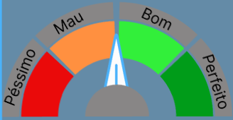

Game Icons
Progress indicator – It indicates the progress of each mission, as the player manages the available energies.
Information balloons – It contains the description or information about the indicators or the energy. It is composed by a title, a description, and the transformation of unities to indicate the quantity.
Possible information messages:
Only produces energy with sun.
The energy consumption surpasses the necessary amount.
There is no stored energy. It is necessary to buy this type of energy to use it.
_____________________
This project has received funding from the European Union’s Horizon 2020
research and innovation programme under grant agreement No 101006468.

Slide 12
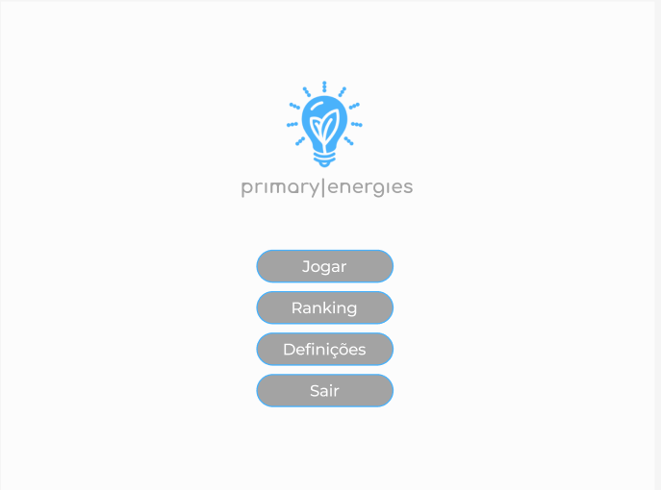
Display - Home
Main buttons, which lead to the next displays.
_____________________
This project has received funding from the European Union’s Horizon 2020
research and innovation programme under grant agreement No 101006468.

Slide 13
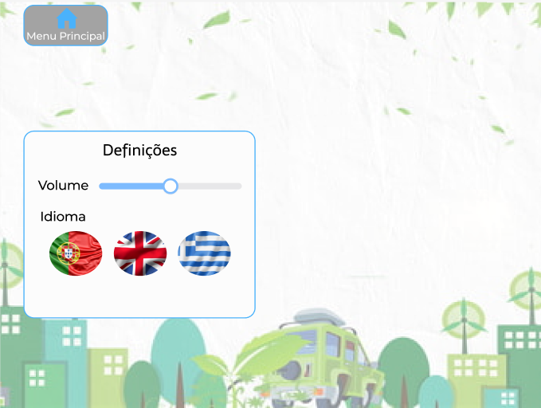
Display – Settings
Leads to main display (Home).
Display of the available settings of the game.
Changing the game language.
_____________________
This project has received funding from the European Union’s Horizon 2020
research and innovation programme under grant agreement No 101006468.

Slide 14
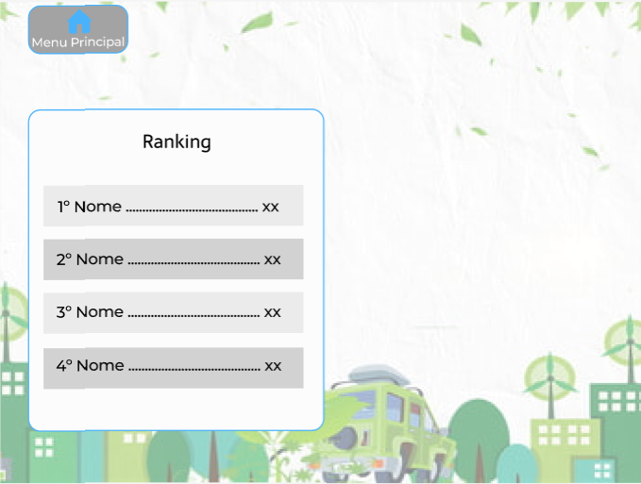
Display - Ranking
Leads to main display (Home).
Display with the ranking of the players, from best to worst.
In each line there is the name, the place, and the score of the respective player.
_____________________
This project has received funding from the European Union’s Horizon 2020
research and innovation programme under grant agreement No 101006468.

Slide 15

Display - Players
Leads to main display (Home).
Display with a list of already created players and the possibility of creating a new one.
By clicking, it will start or continue the saved game on the respective account.
By clicking, a text box to write the name of the new player will appear, creating a new “account”.
_____________________
This project has received funding from the European Union’s Horizon 2020
research and innovation programme under grant agreement No 101006468.

Slide 16
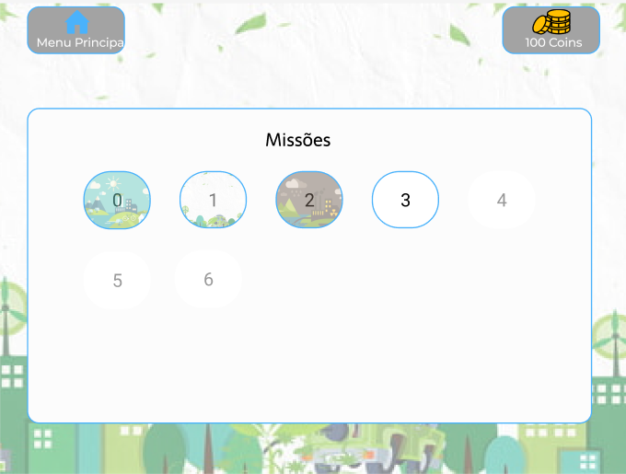
Display – Missions Menu
Leads to main display (Home).
Leads to the missions menu.
Display with a list of the missions.
Blocked mission.
New mission, unlocked.
Completed missions, where the game indicator shows no progress to sustainability.
Completed mission, where the game indicator shows neutral progress to sustainability.
Completed mission, where the game indicator shows good progress to sustainability.
_____________________
This project has received funding from the European Union’s Horizon 2020
research and innovation programme under grant agreement No 101006468.

Slide 17
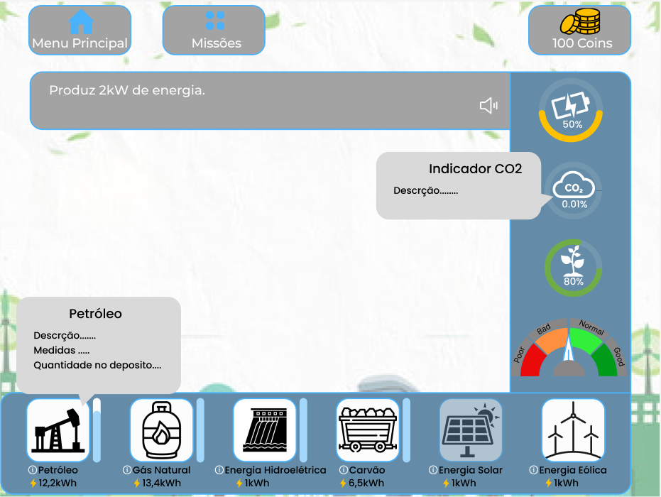
Leads to main display (Home).
Leads to the missions menu.
Display – Game
Leads to the shop display.
Description of the missions, indicating the necessities and the favorable situations to apply the energies.
Indicators.
Information balloons.
Processing zone, where the energies are placed when dragged.
Barra que indica a quantidade de armazenamento que existe disponível para a energia.
Types of energy.
_____________________
This project has received funding from the European Union’s Horizon 2020
research and innovation programme under grant agreement No 101006468.

Slide 18
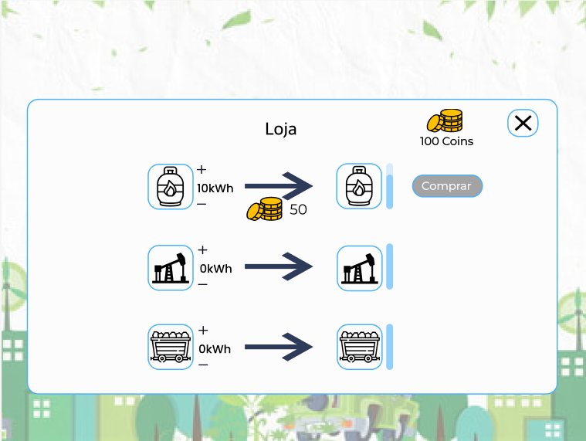
Display to buy energies and to fill the reservoir.
Display - Shop
Close the panel and go back to the previous display.
Amount of coins to buy one amount of energy.
Buying the energy.
Amount of energy in the reservoir.
Amount of energy.
Add or reduce energy.
_____________________
This project has received funding from the European Union’s Horizon 2020
research and innovation programme under grant agreement No 101006468.

Slide 19
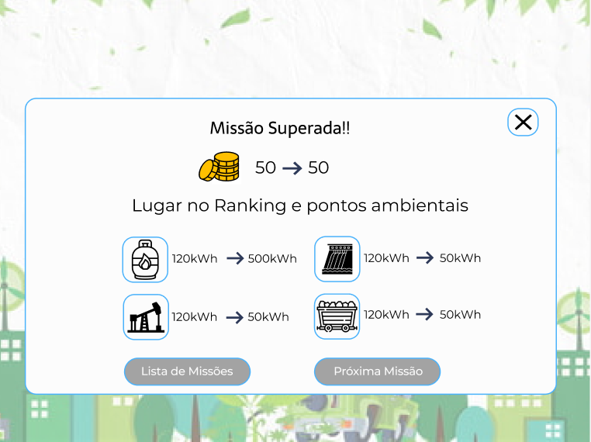
Display – Complete the mission
Shown display when completing the mission, informing if any prize was won or not, the ranking position and the summary of used energy.
Close the panel and go back to the previous display.
Indication of the coins, before and after.
Indication of the ranking place and the points.
Energies used on the mission, before and after.
Go back to the mission list or go to the next mission.
_____________________
This project has received funding from the European Union’s Horizon 2020
research and innovation programme under grant agreement No 101006468.

Slide 20
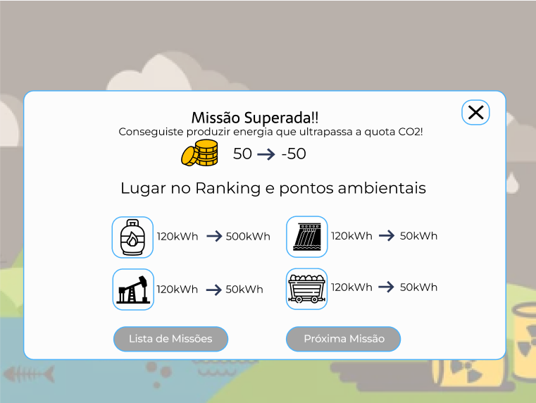
Display – Completing the mission – penalization
_____________________
This project has received funding from the European Union’s Horizon 2020
research and innovation programme under grant agreement No 101006468.

Slide 21
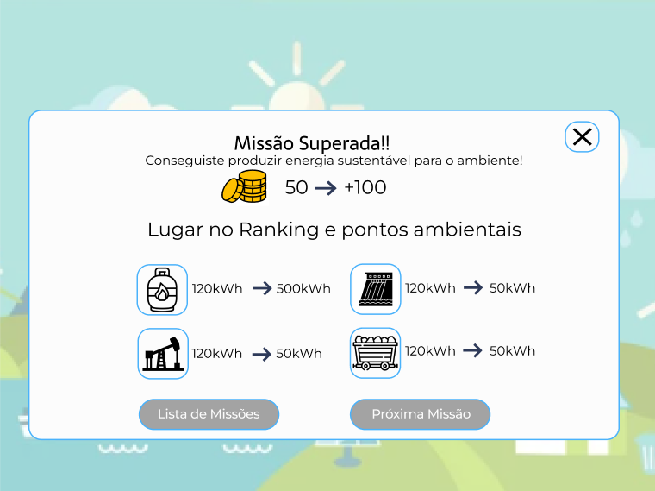
Display – Completing the mission – prize
_____________________
This project has received funding from the European Union’s Horizon 2020
research and innovation programme under grant agreement No 101006468.

Slide 22
See you later!
_____________________
This project has received funding from the European Union’s Horizon 2020
research and innovation programme under grant agreement No 101006468.

