Slide 1



2021
Scenario 3
School Project and Tutorial of How to make a Poster
PAFSE: Partnerships for Science Education
Project approved under Horizon 2020: Science with and for Society
Call: H2020-SwafS-2018-2020
Topic: Open schooling and collaboration on science education
_____________________
This project has received funding from the European Union’s Horizon 2020
research and innovation programme under grant agreement No 101006468.

Slide 2
School Project
With Scenario 1 already implemented, the final activity is starting: the school project;
In this project, each group will need to create a poster about the themes mentioned during the implementation of the scenario, not forgetting to brought up the measures to contest the existing health public problem;
After every group presents their poster to the school, the best poster will be chosen, and then, upgraded, with the intent of presenting that poster to the whole school community.
_____________________
This project has received funding from the European Union’s Horizon 2020
research and innovation programme under grant agreement No 101006468.

Slide 3

How to Create a Poster
_
_____________________
This project has received funding from the European Union’s Horizon 2020
research and innovation programme under grant agreement No 101006468.

Slide 4
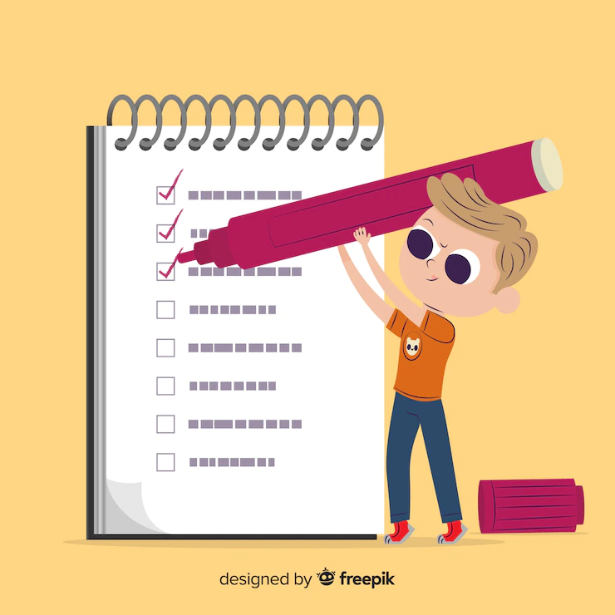
What is a Poster?
Document with big dimensions with the intent of presenting the results of an investigation, research, project, among others;
It is composed by text, images, graphics, drawings, among others… which makes the information more complete and more attractive to the reader;
It pretends to transmit, quickly and clearly, the general ideas of a document.
_____________________
This project has received funding from the European Union’s Horizon 2020
research and innovation programme under grant agreement No 101006468.

Slide 5
Poster Characteristics
Identification of the institution’s name, logo, contacts, and the documents authors;
Small text, but with relevant information;
Pictorial elements: Images, graphs, tables, schemes, maps, drawings, among others;
Well defined and identified titles;
Use of arrows and numbers, to guide the reader while evaluating the document;
Balance between colors and fonts;
Balance between type and size of the letters.
_____________________
This project has received funding from the European Union’s Horizon 2020
research and innovation programme under grant agreement No 101006468.

Slide 6
Poster Structure
The most common components on a poster are:
Title;
Author’s identification;
Summary;
Introduction/goals;
Development – What was done;
Conclusions – Tables, graphs, images, figures, among others.
_____________________
This project has received funding from the European Union’s Horizon 2020
research and innovation programme under grant agreement No 101006468.

Slide 7
Usual Mistakes in a Poster
Too much text;
Figures without clarity (by being printed with big dimensions);
Too much variety of colors and fonts;
Titles disorganized;
Lack of identification of the institution or of the authors;
Spelling mistakes;
Lack of identification sources on the pictures and illustrations;
Lack of titles for the illustrations.
_____________________
This project has received funding from the European Union’s Horizon 2020
research and innovation programme under grant agreement No 101006468.

Slide 8
Poster Examples
_
_____________________
This project has received funding from the European Union’s Horizon 2020
research and innovation programme under grant agreement No 101006468.

Slide 9
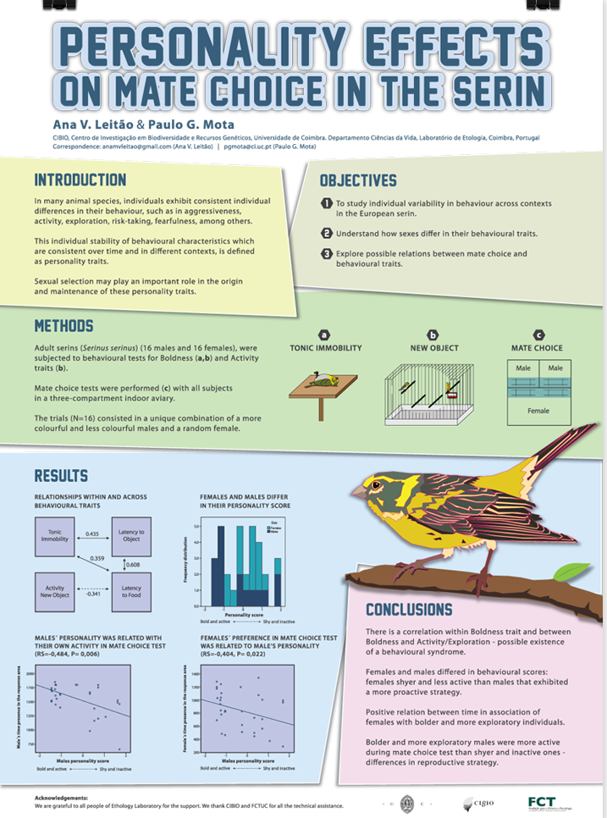
Poster Examples
_
_____________________
This project has received funding from the European Union’s Horizon 2020
research and innovation programme under grant agreement No 101006468.

Slide 10
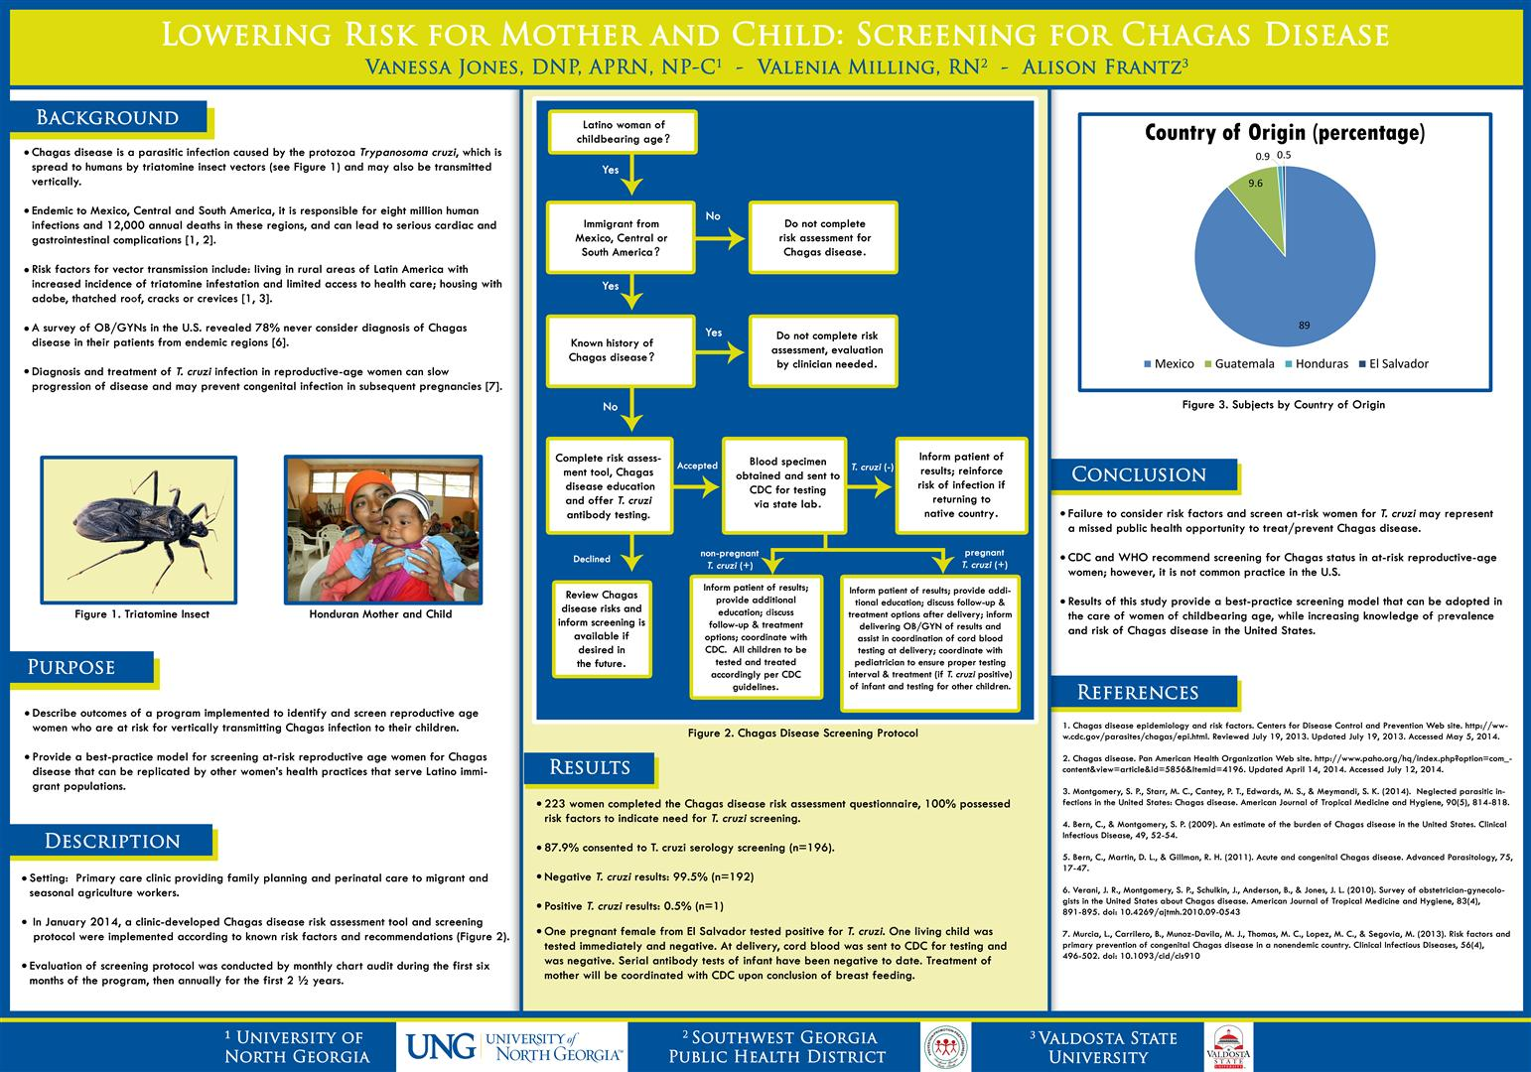
Poster Examples
_
_____________________
This project has received funding from the European Union’s Horizon 2020
research and innovation programme under grant agreement No 101006468.

Slide 11
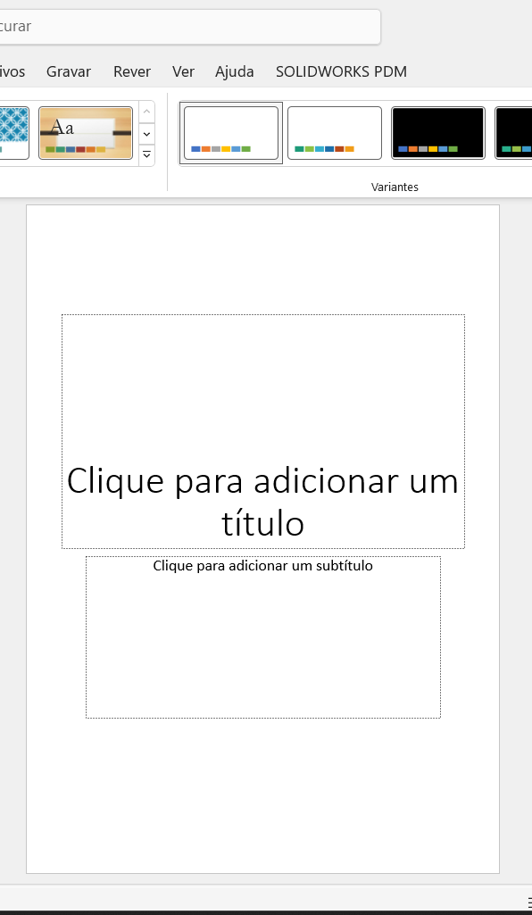
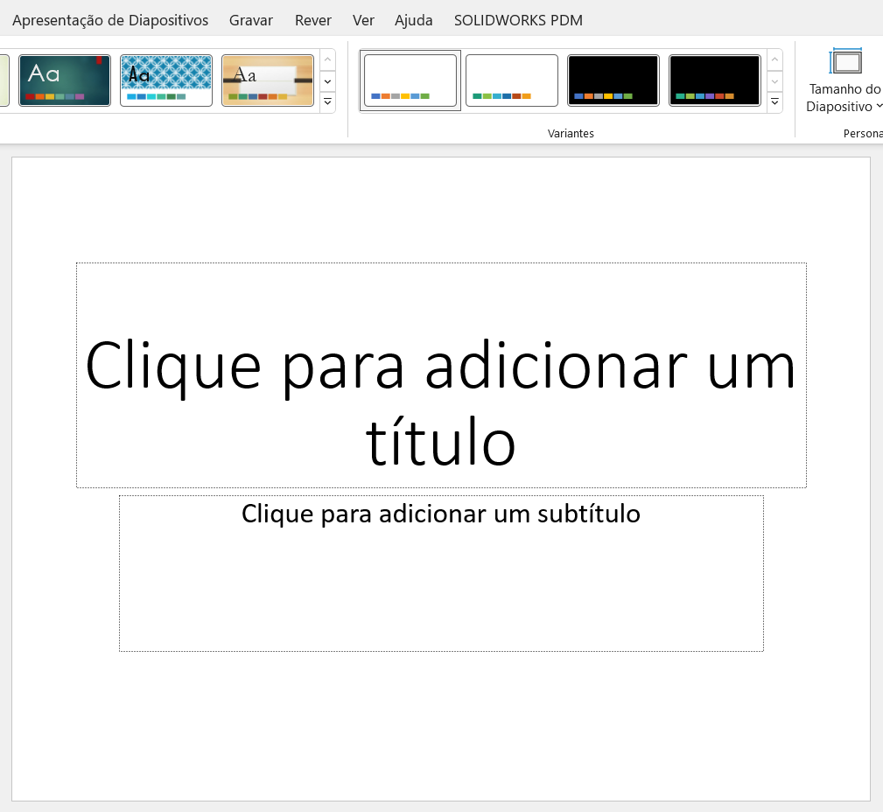
Changing the Slide Dimensions
_
_____________________
This project has received funding from the European Union’s Horizon 2020
research and innovation programme under grant agreement No 101006468.

Slide 12
Changing the Dimension of a poster (to a pre-defined dimension)
Open a Power-Point document;
Select “Structure” on the options next to “File”;
Next, select “Slide Dimension” (upper right corner);
Select “Customize Slide Dimension”;
Select option under “Slide dimension for”, and select the slide configuration wanted, such as A3 or A4, for example;
Select “Ok”.
_____________________
This project has received funding from the European Union’s Horizon 2020
research and innovation programme under grant agreement No 101006468.

Slide 13
Changing the Dimension of a poster (to a certain dimension)
Open a Power-Point document;
Select “Structure” (right side of “File”);
Next, select “Slide Dimension” (upper right corner);
Select “Customize Slide Dimension”;
Select option under “Slide dimension for”, and, following, select “Customize”;
Introduce the length and height wanted (in centimeters!!);
(Optional): If you want to see the slide horizontally or vertically, select the option wanted in ”Orientation” and “Notes, Brochures and Highlights”, which is on the right side after completing step 4.
_____________________
This project has received funding from the European Union’s Horizon 2020
research and innovation programme under grant agreement No 101006468.

Slide 14
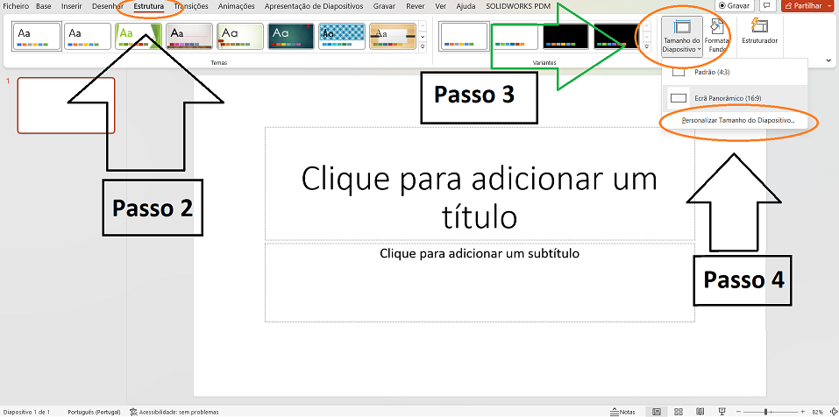
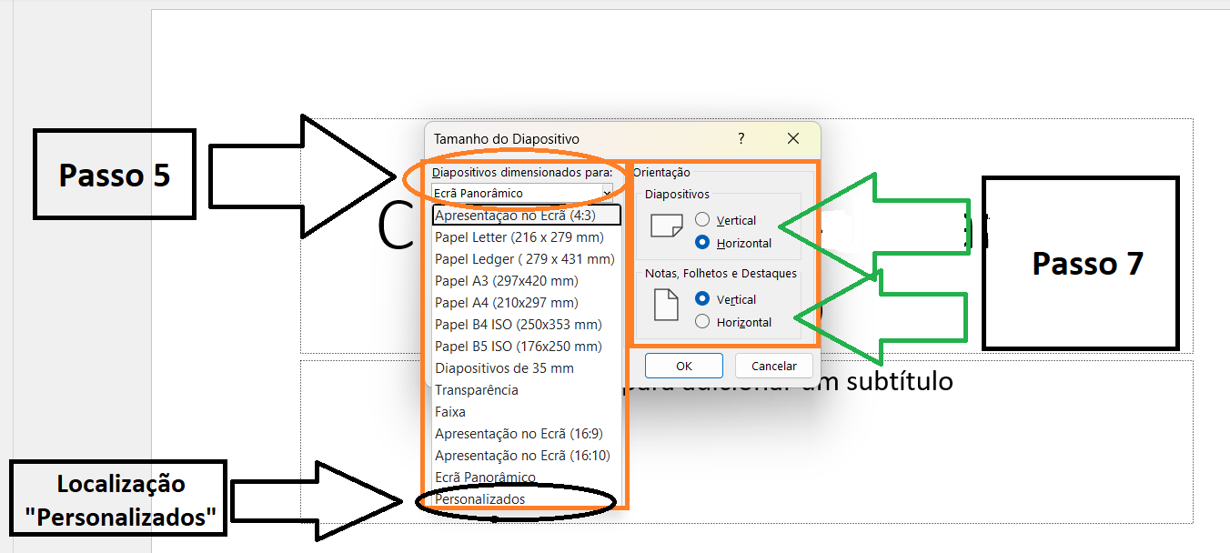
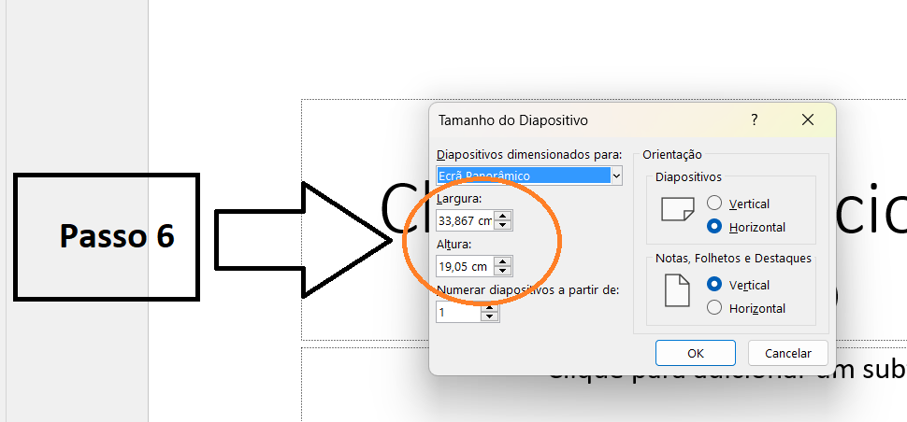
Changing the Slide Dimensions
Size of the bigger slides (length X height):
A0 - (84.1 X 118.9 cm);
A1 - (59.4 X 84.1 cm);
A2 - (42 X 59.4 cm);
_____________________
This project has received funding from the European Union’s Horizon 2020
research and innovation programme under grant agreement No 101006468.

Slide 15
See you later!
_____________________
This project has received funding from the European Union’s Horizon 2020
research and innovation programme under grant agreement No 101006468.

