Slide 1
Presentation Number 1

Slide 2
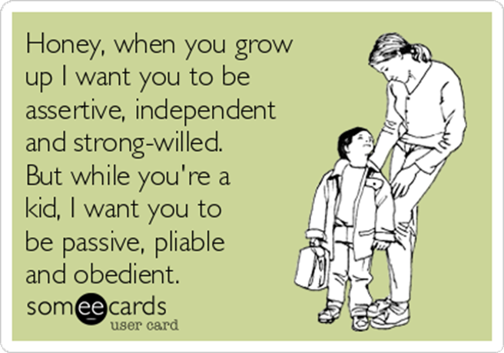
The time o adolescence will come -
even if it is
difficult for adults.
https://www.someecards.com/usercards/viewcard/honey-when-you-grow-up-i-want-you-to-be-assertive-independent-and-strong-willed-but-while-youre-a-kid-i-want-you-to-be-passive-pliable-and-obedient-00379/?tagSlug=family

Slide 3
Already a grown up or a teenager?
https://www.independent.co.uk/arts-entertainment/music/features/madonna-madame-x-age-controversy-sexism-career-billboard-pop-music-a8955036.html

Slide 4
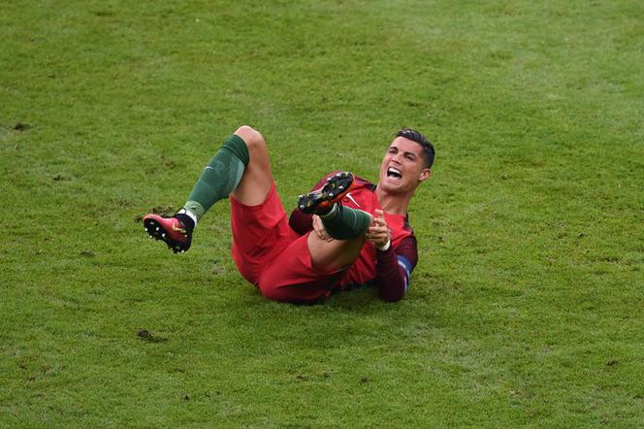
Already a grown up or a teenager?
https://sport.se.pl/pilka-nozna/reprezentacja-polski/ronaldo-nie-zagra-przez-5-miesiecy-straszliwa-diagnoza-po-finale-euro-2016-aa-aNNG-jBYS-wHuV.html

Slide 5
A teenager's brain
It is not hormones but developmental changes in the brain that shape the experiences of adolescents.
During adolescence, the activity of the dopamine system associated with the pursuit of reward increases, that is why adolescents attach more importance to the expected benefits and positive aspects of a given experience than to the risks they are fully aware of.
Source: Sigel (2014) Brainstorm. The Power and Purpose of the Teenage Brain.

Slide 6
A teenager's brain
The pursuit of reward manifests itself in three tendencies:
Impulsivity - no gap between an impulse and an action.
Recommendations for practice: developing reflection and self-awareness.
2. Susceptibility to addiction - increasing the release of dopamine.
Recommendations for practice: developing different, healthier ways to release dopamine (starting from eating ripe bananas, strawberries, avocados; limiting the consumption of sugars and fats, through listening to energetic music, physical activity and meditation, to adequately setting goals and achieving them).
Source: Sigel (2014) Brainstorm. The Power and Purpose of the Teenage Brain.
https://www.ncbi.nlm.nih.gov/pmc/articles/PMC4769029/
Źródło: Sigel (2016) Burza w mózgu nastolatka.

Slide 7
A teenager's brain
3. Hyperrationality - taking facts into account, ignoring the context. Paying more attention to the expected benefits than to the potential risks.
Recommendations for practice: exercises to broaden the perspective; learning to use intuition, learning to choose positive values, not imaginary reward.

Slide 8
Developmental tasks of adolescence (According to Erikson)
Identity vs confusion of identity,
Faithfulness vs totalitarianism
Therefore, an adolescents must:
- Look for,
- Make decisions,
- Disagree,
- Isolate from others and from themselves,
- Go back in order to go forward
- Change their behavior: from impulsive and random actions to restraint,
- Seek to know themselves,

Slide 9
And you, what do you know about a teenager?

Slide 10
Growing up as the stage where teenagers… ( According to Juul)
…will surely succumb to all the temptations of they teenage years and go through some painful experiences,
…will actively try to clarify there attitude to the following things: alcohol, marijuana (and other drugs), sex, pornography and falling in love,
… will start to scrupulously distinguish what they can talk to their parents about, and what should be kept for talks with peers.
All the actions that they will take in the coming years, they will take FOR THEMSELVES and not against parents or adults.

