Slide 1
Presentation Number 2

Slide 2


Parents think that teenagers…
Źródło: http://polki.pl; http://zobaczjestem.pl/

Slide 3
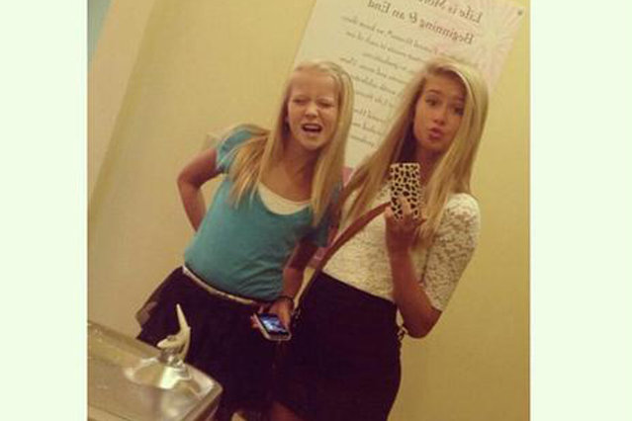
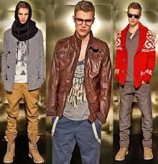
Grandparents think that teenagers…
Zródło: naTemat.pl; w-spodnicy.pl

Slide 4

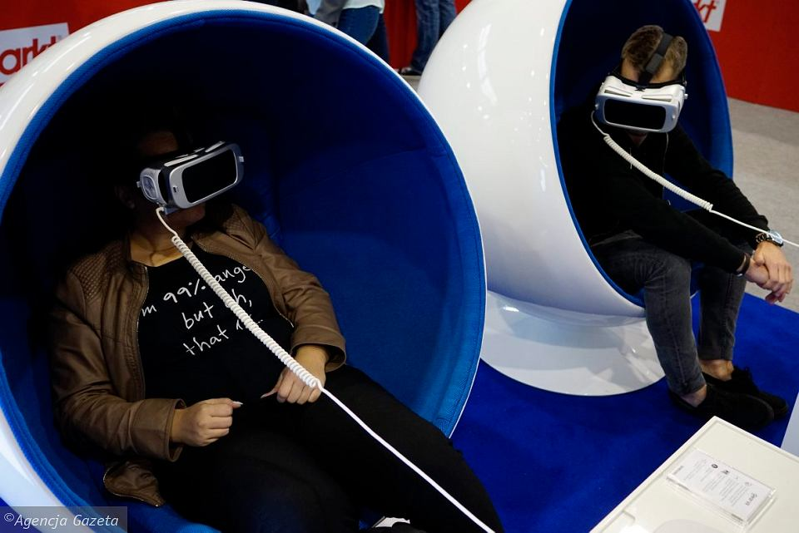
Teachers think that teenagers…
Zródło:Kobieta - Dziennik.pl; Gazeta Wyborcza

Slide 5


And teenagers…
Zródło:Onet Kobieta;

Slide 6


And teenagers…
..
Zródło: Depositphotos;

Slide 7

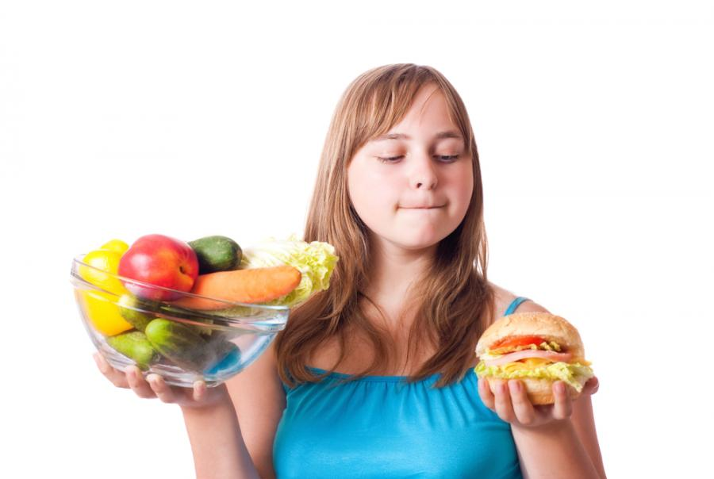


And teenagers also ... and more ...
Zródło: Depositphotos; Kobieta - Dziennik

Slide 8
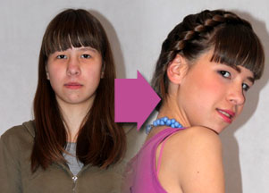
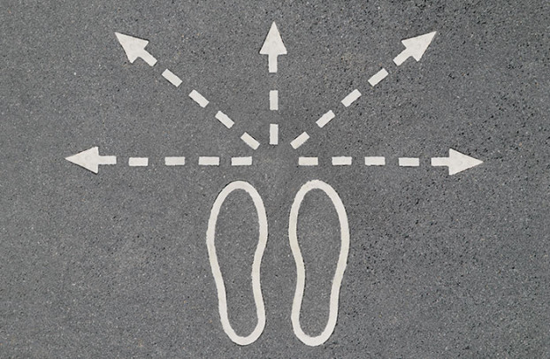
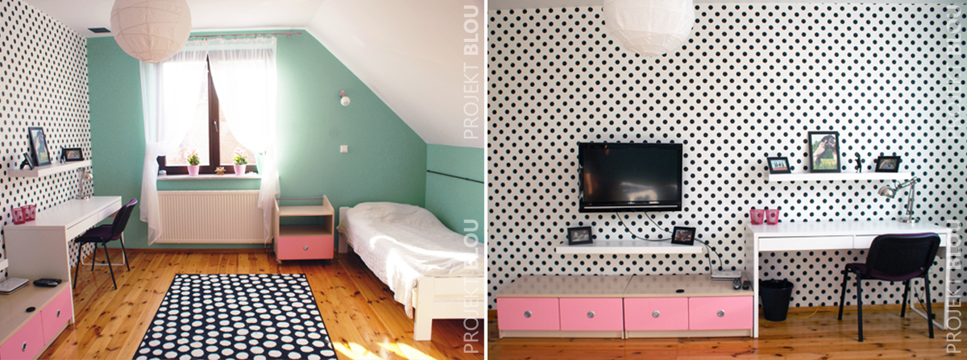
And teenagers also ... and more ...
…are constantly changing
because it's the best time for CHANGES ...
Źródło: Zeberka.pl; Projekt Blou; http://ps-po.pl/

Slide 9
What do the youth know?
The youth konow what they do wrong
but often do not know how to do it differently?

Slide 10
We invite you to practise☺

Slide 11
On the next slide you will see picture of a fish.
What do you think this fish is like?
Pretty, ugly, it devours a worm, dangerous, it swims nicely?

Slide 12
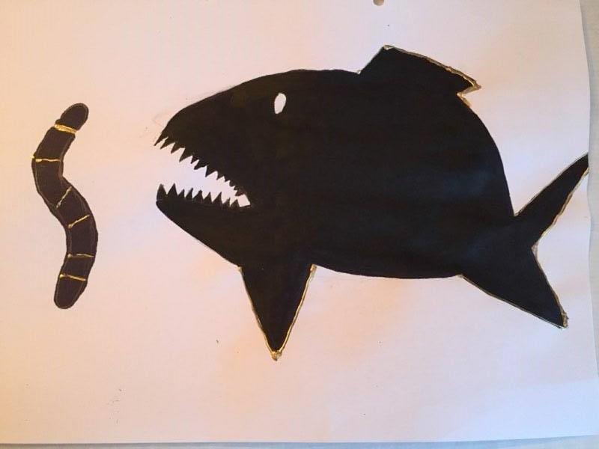
Zapraszam do ćwiczenia ☺

Slide 13
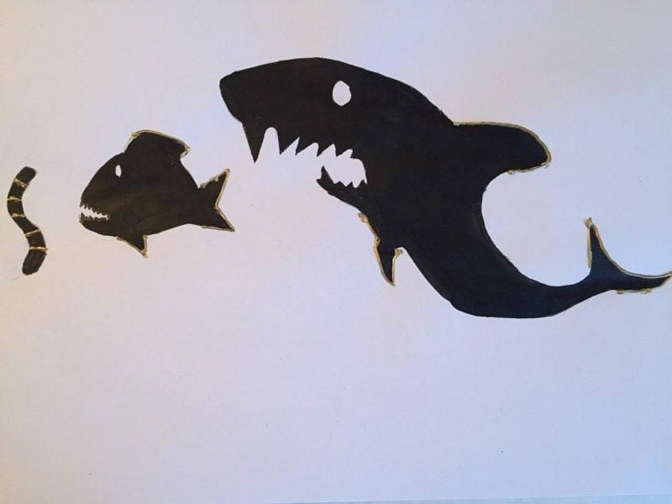
And now, what do you think of the same fish?
Zapraszam do ćwiczenia ☺

Slide 14
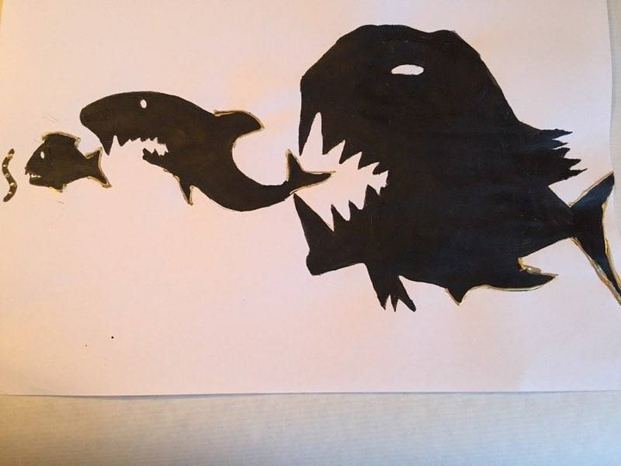
And now, what do you think of the same and the second fish?
Zapraszam do ćwiczenia ☺

Slide 15
Broadening the perspective
How can this exercise change the way you view your child?
One of the techniques of the solution-focused approach teaches how to see the context. What is the importance of broadening the primary perception area depending on the context? Sometimes something seems to be something, but then it seems different.

