Slide 1
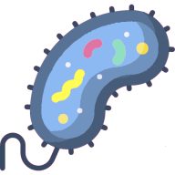

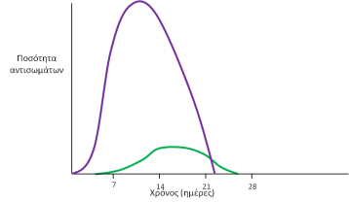
Adaptive immune response
Contributors of the Digital Learning Object
Bacterial infection
Viral infection
Select one of these:
Primary and secondary immune response

Slide 2
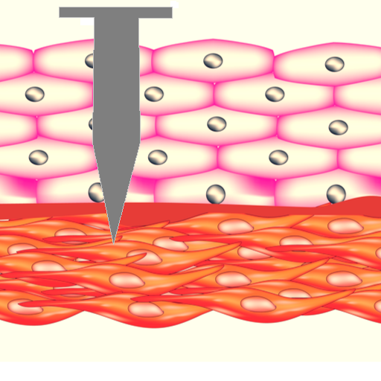
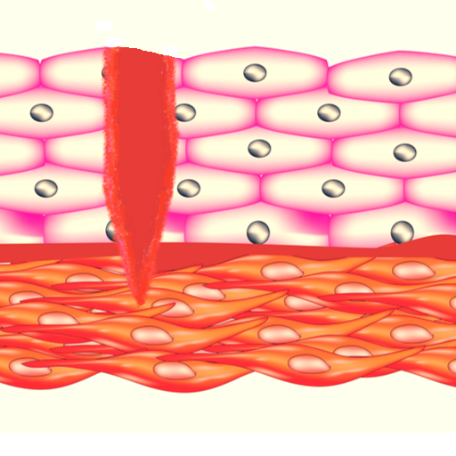
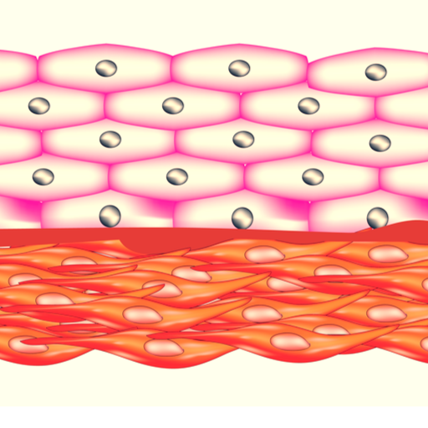

Bacterial infection (1/7)
Bacteria are constantly entering the human body from points where the human’s interior meets the environment. Such points are the eyes, the nose, the mouth and small or large wounds on skin.
Initial menu
Back
Next

Slide 3
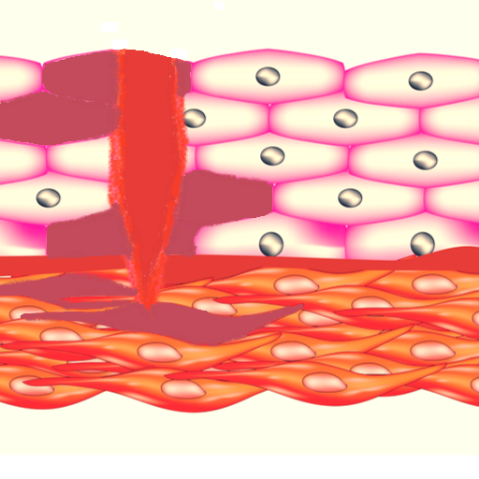

Bacterial infection (2/7)
If the human body is hospitable for the bacteria, they start to reproduce. Each bacterium divides into two, each one of the new bacteria divides, again, into to, and so on.
Bacteria usually produce toxic substances , called toxins, which harm or kill the human cells.
If bacteria increase in number a lot, or produce toxins, they disturb the proper function of the body, and, consequently, we consider to have a bacterial infection.
Initial menu
Back
Next

Slide 4
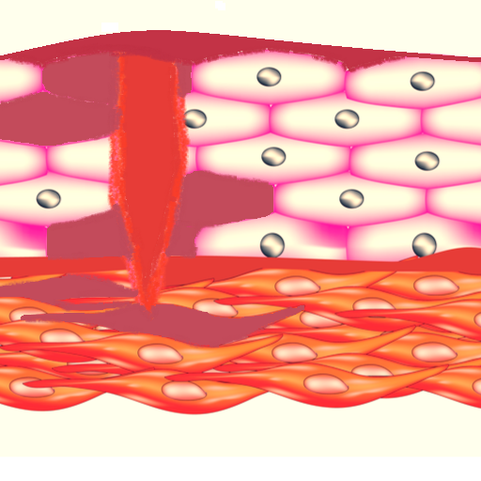



Bacterial infection (3/7)
The human body is clearly getting an attack by bacteria. The first defense mechanisms against pathogens are activated.
At first, the infected area swells, gets reddish and the temperature rises locally. This is called an inflammation. At some cases the total temperature of the body rises, so we have fever.
(General immune response (the same for every pathogen)
Specialized cells (macrophages and dendritic cells) arrive at the infected area destroying the bacteria and the toxin molecules via phagocytosis. However, after destroying some pathogens they die themselves, too.
Inflammation (a local rise in temperature)
Fever (a general rise in temperature)
Phagocytosis of the pathogens by macrophages and dendritic cells
All these mechanisms aim to combat all kinds of pathogens, indiscriminately. They comprise the general immune response.
Watch a video of a real phagocytocis of bacterial by macrophages!
https://www.youtube.com/watch?v=BlPlgGbb2IU
Initial menu
Back
Next

Slide 5

Bacterial infection (4/7)
Some of the macrophages and dendritic cells have survived and carry parts of the bacteria and toxins to special immune cells (B lymphocytes).
Specific immune response (specialized against each pathogen)
Recognition of the pathogens by the B lymphocytes
B lymphocytes recognize these pathogen parts, after some period of time.
Initial menu
Back
Next

Slide 6

Bacterial infection (5/7)
B lymphocytes have recognized what exactly type of bacterium is the pathogen and they coordinate defense mechanisms completely specialized against this pathogen.
Specific immune response (specialized against each pathogen)
Production of antibodies
B lymphocytes ignite the production of large quantities of antibodies. Antibodies are proteins that ‘lock’ exactly upon the bacteria and the toxins, because they have been manufactured especially against them.
As the antibodies ‘stick’ to the pathogens, they inactivate them, the infection is confronted and the organism gets cured.
Initial menu
Back
Next

Slide 7

Bacterial infection (6/7)
The infection has been successfully administrated and the pathogens have been fully defeated. This process lasts usually for about 10-20 days.
Furthermore, B lymphocytes promote the creation of a small number of specialized memory cells, strictly against this pathogen. Their role is to remain in the body and ‘remember’ this pathogen, so as to quickly confront them in case the enter the body again.
Specific immune response (specialized against each pathogen)
Creation of memory cells
Damaged tissues are healed after a few days and dead cells are replaced by new healthy cells.
Initial menu
Back
Next

Slide 8
Bacterial infection (7/7)
1. In which way do bacteria harm human cells?
  Bacteria enter human cells, reproduce there and destroy them.
  Bacteria perform phagocytosis to human cells.
  Bacteria produce toxic substances, which prevent the proper function of the human body .
Show answers
2. Which of the following defense mechanisms belongs to the general immune response, which means that is the same for every microbe?
  Inflammation.
  Creation of memory cells.
  Antibodies production.
3. Which of the following stick onto the bacteria leading to their inactivation?
  Antibodies.
  B lymphocytes.
  Macrophages.
Initial menu
Back
Next

Slide 9
Bacterial infection (7/7)
1. In which way do bacteria harm human cells?
  Bacteria enter human cells, reproduce there and destroy them.
  Bacteria perform phagocytosis to human cells.
  Bacteria produce toxic substances, which prevent the proper function of the human body .
Bacteria often produce toxins, which are harmful substances for the human body.
2. Which of the following defense mechanisms belongs to the general immune response, which means that is the same for every microbe?
  Inflammation.
  Creation of memory cells.
  Antibodies production.
  Inflammation is a local rise in temperature at the infected area, usually accompanied with some redness and swelling. It is a general defense mechanism against every pathogen.
3. Which of the following stick onto the bacteria leading to their inactivation?
  Antibodies.
  B lymphocytes.
  Macrophages.
  Antibodies are small specialized molecules, that are produced in large quantities and stick onto the pathogen so as to inactivate it.
Initial menu
Back
Next

Slide 10

Viral infection (1/7)
Viruses are constantly entering the human body from points where the human’s interior meets the environment. Such points are the eyes, the nose, the mouth and small or large wounds on skin.
Initial menu
Back
Next

Slide 11

Viral infection (2/7)
If the human body is hospitable for the viruses, they start to reproduce.
Viruses attach to the outer surface of human cells and introduce their genetic material (DNA or RNA) into them.
Then, the viral DNA or RNA ‘directs’ the infected human cells to create lots of duplicates of the viruses in them.
The new viruses exit the infected cells, are dispersed in the tissue and infect new cells, in turn.
Infected human cells are often not killed, but their proper function gets disturbed.
If the viruses increase in number a lot and infect a lot of human cells, we consider to have a viral infection.
Initial menu
Back
Next

Slide 12
Viral infection (3/7)
The human body is clearly getting an attack by viruses. The first defense mechanisms against pathogens are activated.
At first, the infected area swells, gets reddish and the temperature rises locally. This is called an inflammation. At some cases the total temperature of the body rises, so we have fever.
General immune response (the same for every pathogen)
Inflammation (a local rise in temperature)
Specialized cells (macrophages and dendritic cells) arrive at the infected area destroying some viruses via phagocytosis. However, after destroying some pathogens they die themselves ,too.
Fever (a general rise in temperature)
Phagocytosis of the pathogens by macrophages and dendritic cells
All these mechanisms aim to combat all kinds of pathogens, indiscriminately. They comprise the general immune response.
Initial menu
Back
Next

Slide 13

Viral infection (4/7)
Some of the macrophages and dendritic cells have survived and carry parts of the virus to special immune cells (B and T lymphocytes).
Specific immune response
(specialized against each pathogen)
B and T lymphocytes recognize these pathogen parts, after some time.
Recognition of the pathogens by B and T lymphocytes
Initial menu
Back
Next

Slide 14
Viral infection (5/7)
B and T lymphocytes have recognized what exactly type of virus is the pathogen and they coordinate defense mechanisms completely specialized against this pathogen.
Specific immune response
(specialized against each pathogen)
B lymphocytes ignite the production of large quantities of antibodies. Antibodies are proteins that ‘lock’ exactly upon the viruses, because they have been manufactured especially against them.
Production of antibodies
As the antibodies ‘stick’ to the pathogens, they inactivate them, the infection is confronted and the organism gets cured.
Initial menu
Back
Next

Slide 15
Viral infection (6/7)
The infection has been successfully administrated and the pathogens have been fully defeated. This process lasts usually for about 10-20 days.
Furthermore, B lymphocytes, along with T lymphocytes, promote the creation of a small number of specialized memory cells, strictly against this pathogen. Their role is to remain in the body and ‘remember’ this pathogen, so as to quickly confront them in case the enter the body again.
Specific immune response
(specialized against each pathogen)
Creation of memory cells
Infected human cells are destroyed and replaced by new healthy cells. Damaged tissues are, also, healed after a few days
Initial menu
Back
Next

Slide 16
Viral infection (7/7)
1. In which way do viruses harm human cells?
  Viruses reproduce in human cells and cause them damage.
  Viruses perform phagocytosis on the cells of the immune system.
  Viruses produce toxic substances, that block the body’s proper function.
Show answers
2. Which of the following cell types of the immune system takes part in phagocytosis?
  Macrophages.
  Memory cells.
  B lymphocytes.
3. Which of the following is responsible for the maintenance of immunity over time?
  Antibodies.
  Dendritic cells.
  Memory cells.
Initial menu
Back
Next

Slide 17
Viral infection (7/7)
1. In which way do viruses harm human cells?
  Viruses reproduce in human cells and cause them damage.
  Viruses perform phagocytosis on the cells of the immune system.
  Viruses produce toxic substances, that block the body’s proper function.
Viruses enter human cells, take advantage of them and produce multiple duplicates of themselves. This procedure disturbs the human cells’ function.
2. Which of the following cell types of the immune system takes part in phagocytosis?
  Macrophages.
  Memory cells.
  B lymphocytes.
  Macrophages and dendritic cells perform phagocytosis, which means that destroy indiscriminately every pathogen type entering the human body.
3. Which of the following is responsible for the maintenance of immunity over time?
  Antibodies.
  Dendritic cells.
  Memory cells.
  Memory cells live for many years in the human body and their role is to remember of each pathogen the immune system has encountered with, In order to confront with it quickly and effectively in case it infects the human body again in the future.
Initial menu
Back
Next

Slide 18
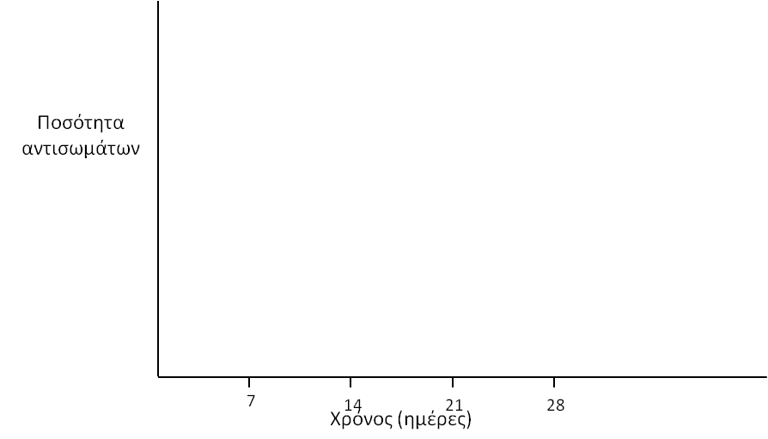
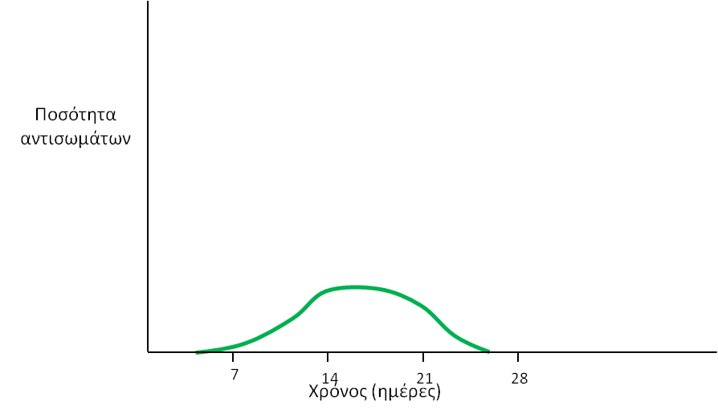
Primary immune response (1/3)
Primary immune response takes place when our body encounters a pathogen for the first time.
Quantity of antibodies
The microbes are destroyed through phagocytosis by macrophages and dendritic cells.
A lot of time is needed for the recognition of the pathogen by the lymphocytes and its defeate, because it is completely unknown to our immune system.
Time (days)
6. Creation of memory cells
1. Reproduction of microbes in the human body
End of the disease
Initial menu
4. Antibodies production
Back
Next
3. Recognition of microbes by lymphocytes
2. Phagocytosis of microbes
5. Inactivation of microbes

Slide 19
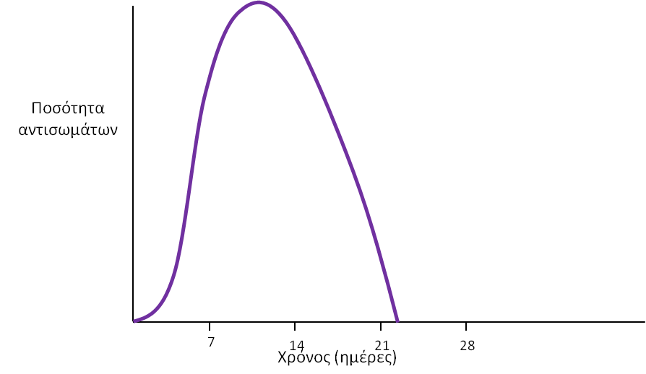
Secondary immune response (2/3)
Secondary immune response takes place when our body encounters a pathogen that has already encountered in the past, as well.
Quantity of antibodies
The microbes are destroyed through phagocytosis by macrophages and dendritic cells.
The microbes are destroyed through phagocytosis by macrophages and dendritic cells. The body has already specialized memory cells against this pathogen. These cells instantly recognize the microbe and produce a large amount of antibodies to defeat them.
Time (days)
End of the disease
1. Reproduction of microbes in the human body
Initial menu
4. Antibodies production
Back
Next
3. Recognition of microbes by memory cells
2. Phagocytosis of microbes
5. Inactivation of microbes

Slide 20

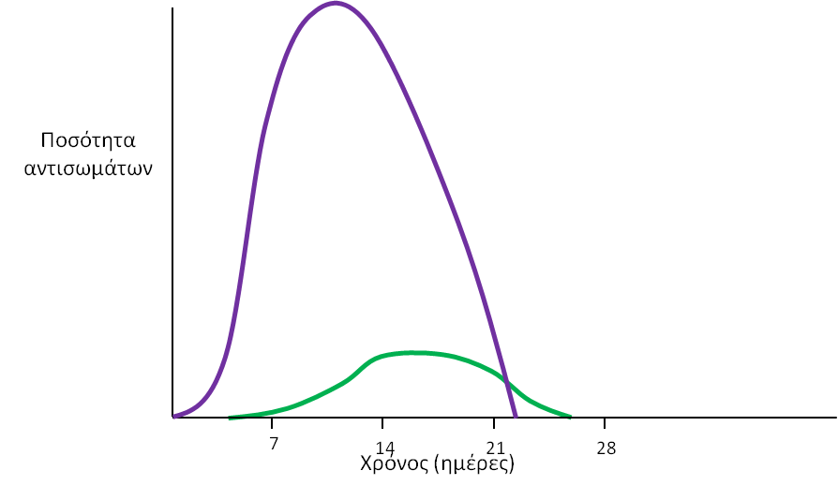
Comparison of primary and secondary immune response (3/3)
At secondary immune response the body is ready because it already has memory cells. So, the immune response accelerates and proceeds much faster.
During secondary immune response the body produces a much larger amount of antibodies, and the pathogens get inactivated more effectively.
Quantity of antibodies
During secondary immune response the disease ends much sooner.
The secondary immune response starts nearly instantly after the pathogen enters the human body, because there is no much time lost for its recognition. Therefore, there is not often sufficient time for the patient to develop severe symptoms of the disease.
Time (days)
Initial menu
Back
Next

Slide 21




Contributors of the Digital Learning Object
This project has received funding from the European Union’s Horizon 2020 Research and Innovation
Programme under grant agreement No 101006468.
Initial menu

