Slide 1



2021
Scenario 1
Learning Guide: Video Analysis from Lessons 3 and 4
PAFSE: Partnerships for Science Education
Project approved under Horizon 2020: Science with and for Society
Call: H2020-SwafS-2018-2020
Topic: Open schooling and collaboration on science education
_____________________
This project has received funding from the European Union’s Horizon 2020
research and innovation programme under grant agreement No 101006468.

Slide 2
Guide Objectives
Train the teachers to lecture lessons 3 and 4 from scenario 1, which are based on the video implementation.
This document contains the step-by-step explanation of what can be observed in each video from lessons 3 and 4.
This document should be analyzed after reading the learning guide from lesson 3 and 4, respectively called “Guiao_Aula3_Professor”, and “Guiao_Aula4_Professor”.
_____________________
This project has received funding from the European Union’s Horizon 2020
research and innovation programme under grant agreement No 101006468.

Slide 3
Video Structure from Lesson 3
As referred in the lesson 3 guide, students must analyze eight videos (1st minute typology + whole simulation), representing four different situations, being as follows:
Situation in which one of the room occupant speaks.
Situation in which one of the room occupant sneezes.
Situation in which one of the room occupant coughs.
Situation in which one of the room occupant speaks without ventilation.
In the first three situations, the room has a ventilation system.
_____________________
This project has received funding from the European Union’s Horizon 2020
research and innovation programme under grant agreement No 101006468.

Slide 4
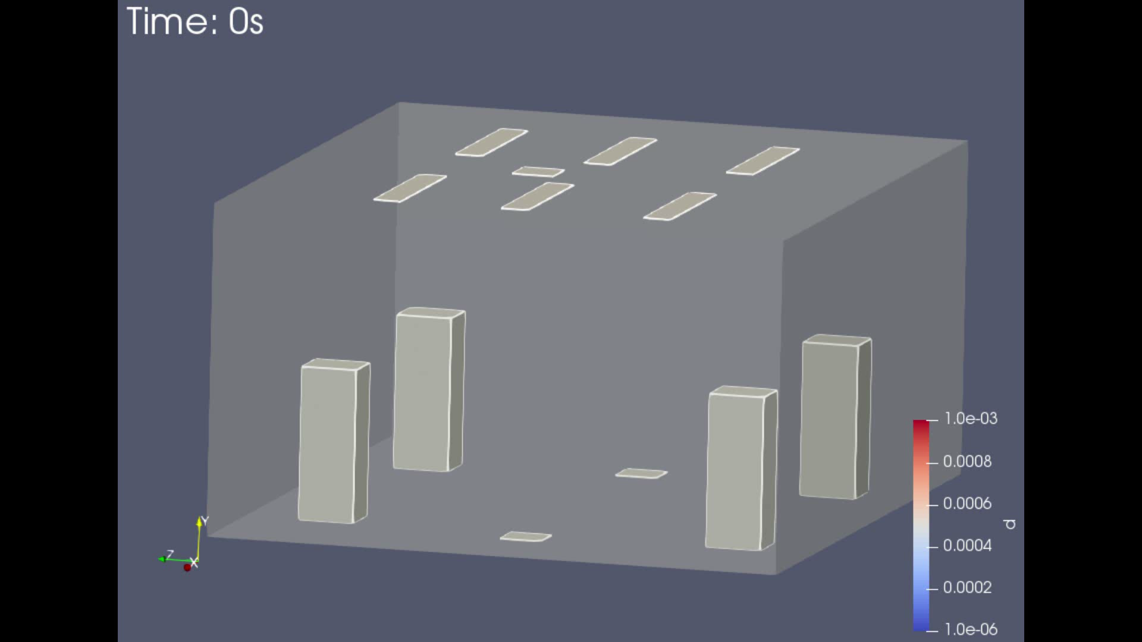
1st Minute Only Videos: Structure
As mentioned in the guide for lesson 3, in this typology there is only possible to watch the first minute of the simulation. The target is that the students analyze the start of the trajectory from the droplets, after they are expelled by the emitter.
In the videos below, it is possible to watch, as an example, the 1st minute typologies to the situations where the occupant speaks and sneezes.
Speaking
Sneezing
_____________________
This project has received funding from the European Union’s Horizon 2020
research and innovation programme under grant agreement No 101006468.

Slide 5
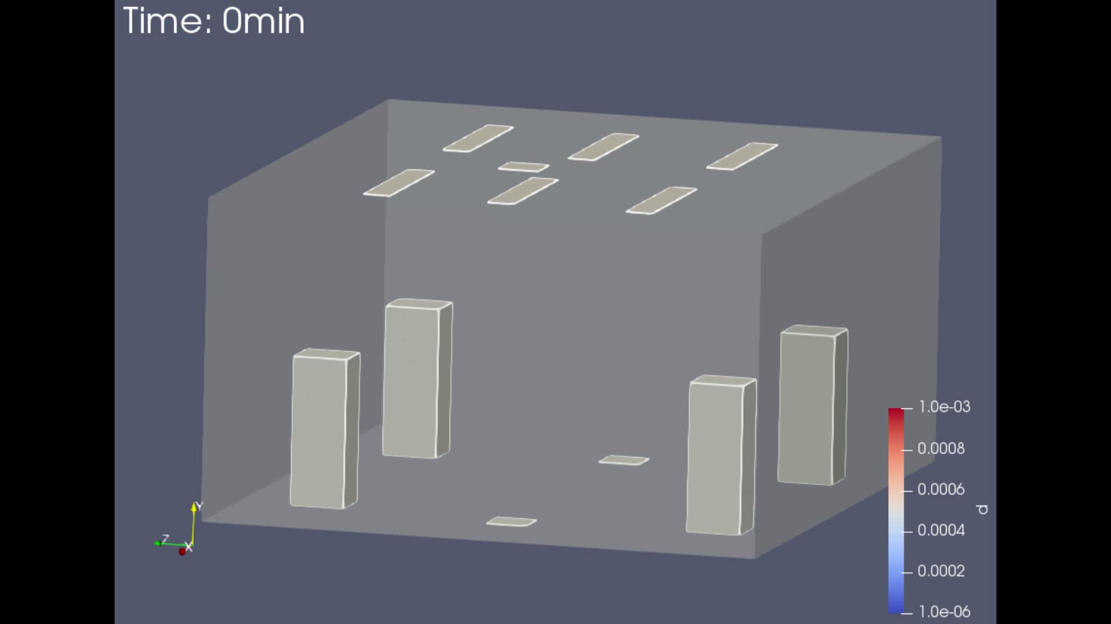
Whole Simulation Videos: Structure
In this typology it is possible to observe the whole simulation, in other words, the whole 60 minutes. It is possible to watch the first minute at the same speed, and the other 59 minutes are analyzed at a superior, but constant, speed.
In the videos below, it is possible to observe, as an example, the video typologies of the whole simulation, both when speaking and when sneezing.
Speaking
Sneezing
_____________________
This project has received funding from the European Union’s Horizon 2020
research and innovation programme under grant agreement No 101006468.

Slide 6
The phenomenon observed in the four situations of lesson 3 (Speak, sneeze, cough and speak with no ventilation) are very similar. The big difference is that these phenomenon occur at different intensity scales.
At a first instance, the video that is going to be analyzed is the one from the whole simulation where the emitter speaks. From there, the differences between the videos from lesson 3 should be identified.
Observed Phenomenon Explained
-
Lesson 3
_____________________
This project has received funding from the European Union’s Horizon 2020
research and innovation programme under grant agreement No 101006468.

Slide 7
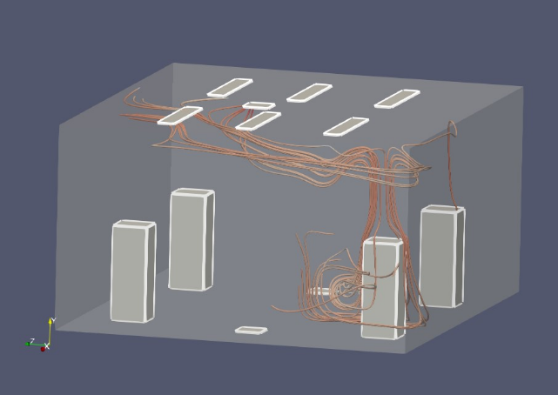
Videos Phenomenon Explained, Lesson 3: Speaking, part I
In this situation, as can be seen in the video (right), the particles follow the air flow direction, describing an “L” shape, which can be verified in the image below the video, representing the air flow in this room.
This phenomenon is based on the particles small dimension, and their pressure force imposed by air, coming out of the ventilation system, which makes the particles follow that direction.
As the ventilation system’s air flow goes from bottom to top, from the diffusers to the extractor, on the ceiling, particles are going to be successively “dragged” to the extractor. Therefore, by the simulation time goes up, less particles stay in the room, as verified in the video.
_____________________
This project has received funding from the European Union’s Horizon 2020
research and innovation programme under grant agreement No 101006468.

Slide 8
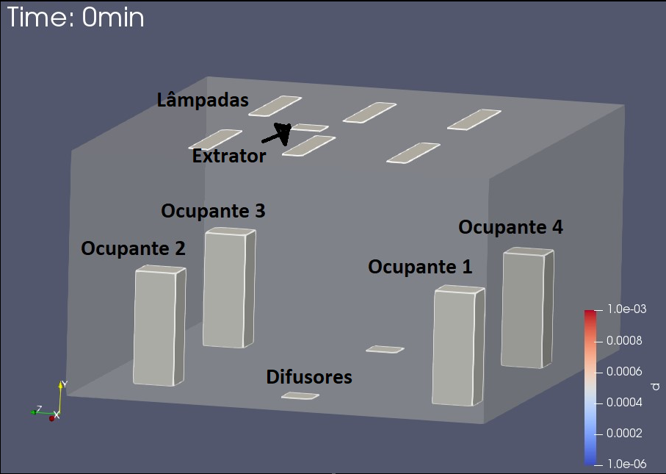
Videos Phenomenon Explained, Lesson 3: Speaking, part II
Yet another phenomenon observed in the video is that a larger quantity of the bigger particles (orange/red) deposited on the ground than the small particles (blue).
Due to their bigger dimension, they tend to deposit easier, both in occupants and on the walls. In other words, if there are no larger particles, a bigger number of them will be extracted.
It is also verified that the geometries in this room (in this case, only the occupants), influences the particles trajectory, posing as a barrier to the particles “normal” flow.
Furthermore, every occupant was exposed to the particles emitted by occupant 1, even if only in a reduced scale. This was due to the ventilation system, which allowed a smaller risk infection. Even so, it is possible to be indirectly infected trough contact with walls, for example, even if unlikely.
_____________________
This project has received funding from the European Union’s Horizon 2020
research and innovation programme under grant agreement No 101006468.

Slide 9
Videos Phenomenon Explained, Lesson 3: Sneezing
Relating to sneezing, every mentioned phenomenon from the speaking situation occur, similarly, as it can be seen in the video on the right.
The one big difference is the amount of emitted particles in both situations, and the changes that it lead to.
While in the speaking simulation, occupant 1 emitted particles for five minutes continuously, in this situation, occupant 1 emitted all the particles in 0,5 seconds, which resulted in a lesser number of emitted particles.
As such, the infection risk on the occupants decreased in this situation, even though that, once again, every occupant was exposed to a residual number of particles.
_____________________
This project has received funding from the European Union’s Horizon 2020
research and innovation programme under grant agreement No 101006468.

Slide 10
Videos Phenomenon Explained, Lesson 3: Coughing
Relating to coughing, every mentioned phenomenon to the speaking and sneezing situation were similar, as it is possible to observe in the video on the right.
The bigger difference was the amount of emitted particles in the three situations, and what it lead to.
In this situation, even lesser particles were emitted than it the two previous situations and, as such, the infection risk was smaller when compared to the two previous. Even so, once again, every occupant was exposed to a residual number of particles.
Both in this situation and in the previous ones, an accumulation of particles can be seen in the area of the extractor. This should be mentioned, as these equipment should be inspected regularly, under consequence of posing a risk of infecting the occupants.
_____________________
This project has received funding from the European Union’s Horizon 2020
research and innovation programme under grant agreement No 101006468.

Slide 11
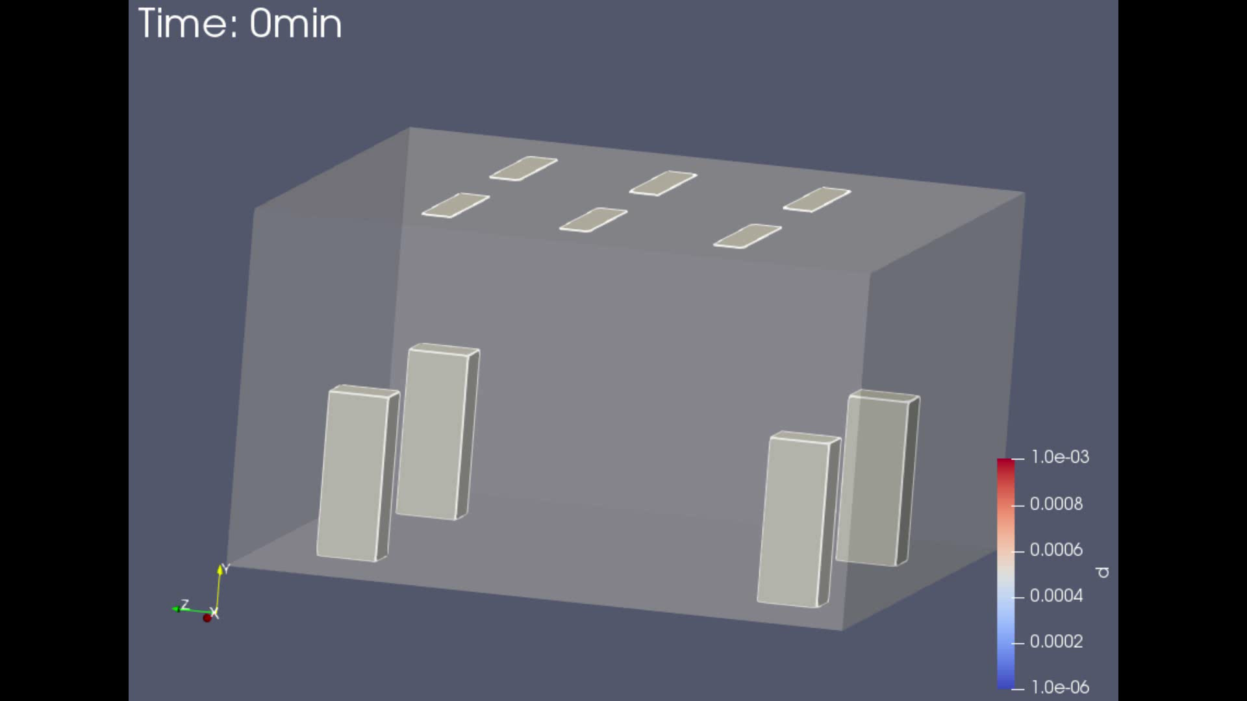
Videos Phenomenon Explained, Lesson 3: Speaking with no ventilation
Comparing to three previous situations, this was the situation with more and bigger differences.
When comparing it to the speaking simulation with ventilation, it is possible to see the same “L” shape trajectory followed by the particles.
The bigger difference is the fact that the particles are not removed from the room, and as such, the infection risk for the occupants is substantially greater, as verified in the video on the right.
_____________________
This project has received funding from the European Union’s Horizon 2020
research and innovation programme under grant agreement No 101006468.

Slide 12
Main Conclusions: Video Analysis Lesson 3
At the end of the analysis of the videos from lesson 3, the main conclusions should be:
Particles tend to follow the air flow crated by the ventilation system, an upward trajectory with an “L” shape in the extractor direction, being successively removed from the room through time.
Occupant infection was almost residual for the three breathing regimes, due to the ventilation system.
The lower the number of emitted particles, the lower is the infection risk for the occupants.
In the situation without ventilation system, the particles were not removed, therefore, the infection risk for the occupants increased.
Over time, it was verified an accumulation of particles in the extractor area.
_____________________
This project has received funding from the European Union’s Horizon 2020
research and innovation programme under grant agreement No 101006468.

Slide 13
In the videos from lesson 4, similarly to the videos from lesson 3, three breathing regimes (speaking, sneezing, coughing) were simulated. The main difference is the three different room configurations in which each regime was simulated.
The explanation from the videos from lesson 4 will be made according to each room configuration, with the objective of establishing the main differences between the observed phenomena in the various configurations, and when compared to lesson 3.
Observed Phenomenon Explained on the videos
-
Lesson 4
_____________________
This project has received funding from the European Union’s Horizon 2020
research and innovation programme under grant agreement No 101006468.

Slide 14
Video Structure from Lesson 4
As referred previously on the lesson 3 and 4 guides, the room configurations are as follows:
Standard Case: ventilation system identic to the case-studies from lesson 3. It just adds the complexity and the number of geometries in the room (occupants closer to realty, adding tables and chairs).
Study case with ventilation system on the ceiling: the ventilation system is totally incorporated on the ceiling (extractor + diffusers).
Study case with natural ventilation: the ventilation system is natural. It is composed by two open windows at 10% and an open door at 10%.
In lesson 4, the main focus is the understating that the particles spread differently, according to the room configurations and, as such, the students will have to analyze only the speaking simulations from configurations 1, 2 and 3, having available both video typologies (only the 1st minute + whole simulation).
_____________________
This project has received funding from the European Union’s Horizon 2020
research and innovation programme under grant agreement No 101006468.

Slide 15
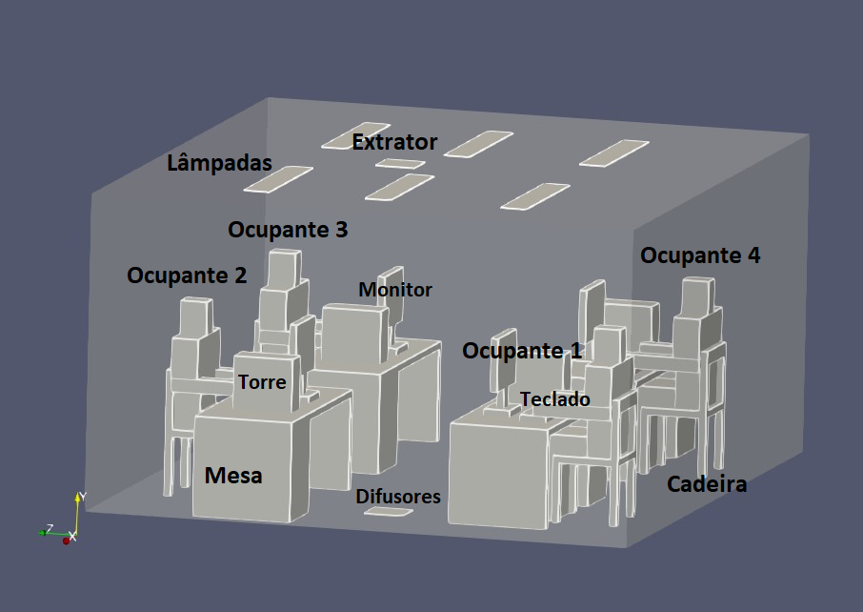
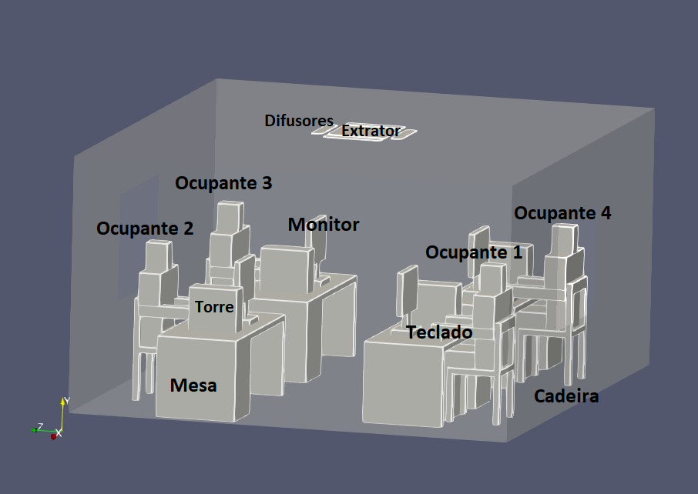
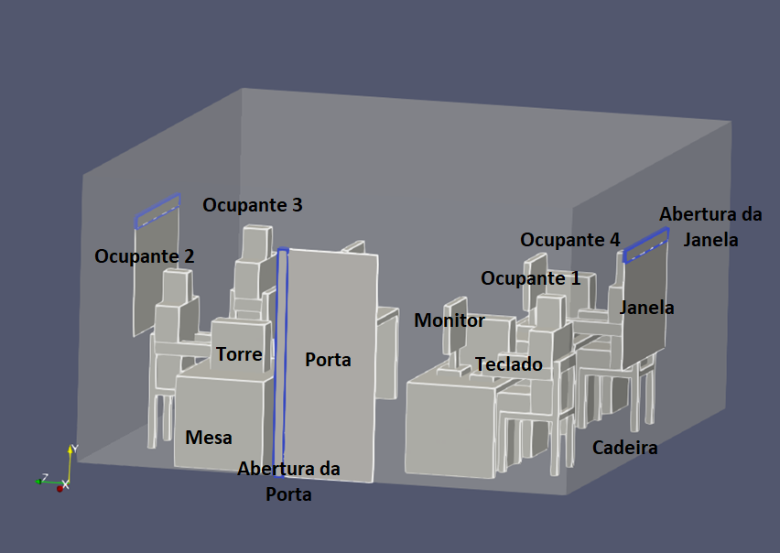
Video Structure from Lesson 4
Ventilation System in the Ceiling
As referred in guide from lesson 4, knowing that the room configurations are different, what is asked is for students to analyze the speaking simulations for each of the three rooms configurations described on the previous slide.
This class corresponding worksheet will have a comparison question between the standard case and the lesson 3 case, since they have a similar ventilation system. Furthermore, there is a question to compare what was seen in the three rooms configurations.
On the images in the right, the constituting geometries are identified in each of the configurations.
Standard Case
Natural Ventilation
_____________________
This project has received funding from the European Union’s Horizon 2020
research and innovation programme under grant agreement No 101006468.

Slide 16
Explained Phenomenon Lesson 4 Video: Standard Case
The main phenomenon observed in lesson 3 are very similar to the case standard:
Particles follow the air flow direction, initially following an “L” shape;
Particles are being successively dragged to the extractor and, consequently, removed from the room due to the upward air flow from the ventilation system.
The particles with a larger dimension (orange/red) drop on the floor in a bigger quantity than the smaller ones (blue).
The smaller the number of emitted particles in each breathing regime, the lower is the infection risk to the room occupants.
The main differences observed between the standard case when relating it to the lesson 3 case, is that there is a bigger number of geometries in the room (tables, chairs, towers, among others), and the fact that humans are more geometrically complex (closer to reality) and, as such, all these elements pose as barriers to the “normal” flow o the particles, interfering their trajectory.
As a consequence, a bigger number of particles is in the room at the end of the simulation, which poses a bigger infection risk to the occupants, as it can be seen in the next slide videos.
_____________________
This project has received funding from the European Union’s Horizon 2020
research and innovation programme under grant agreement No 101006468.

Slide 17
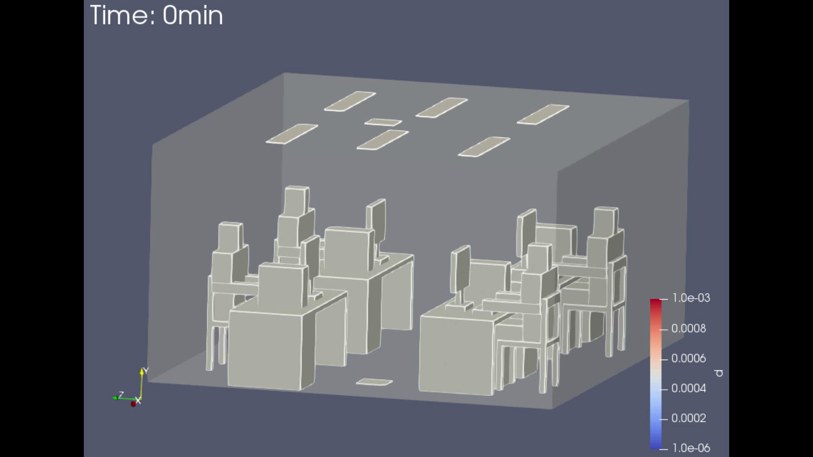
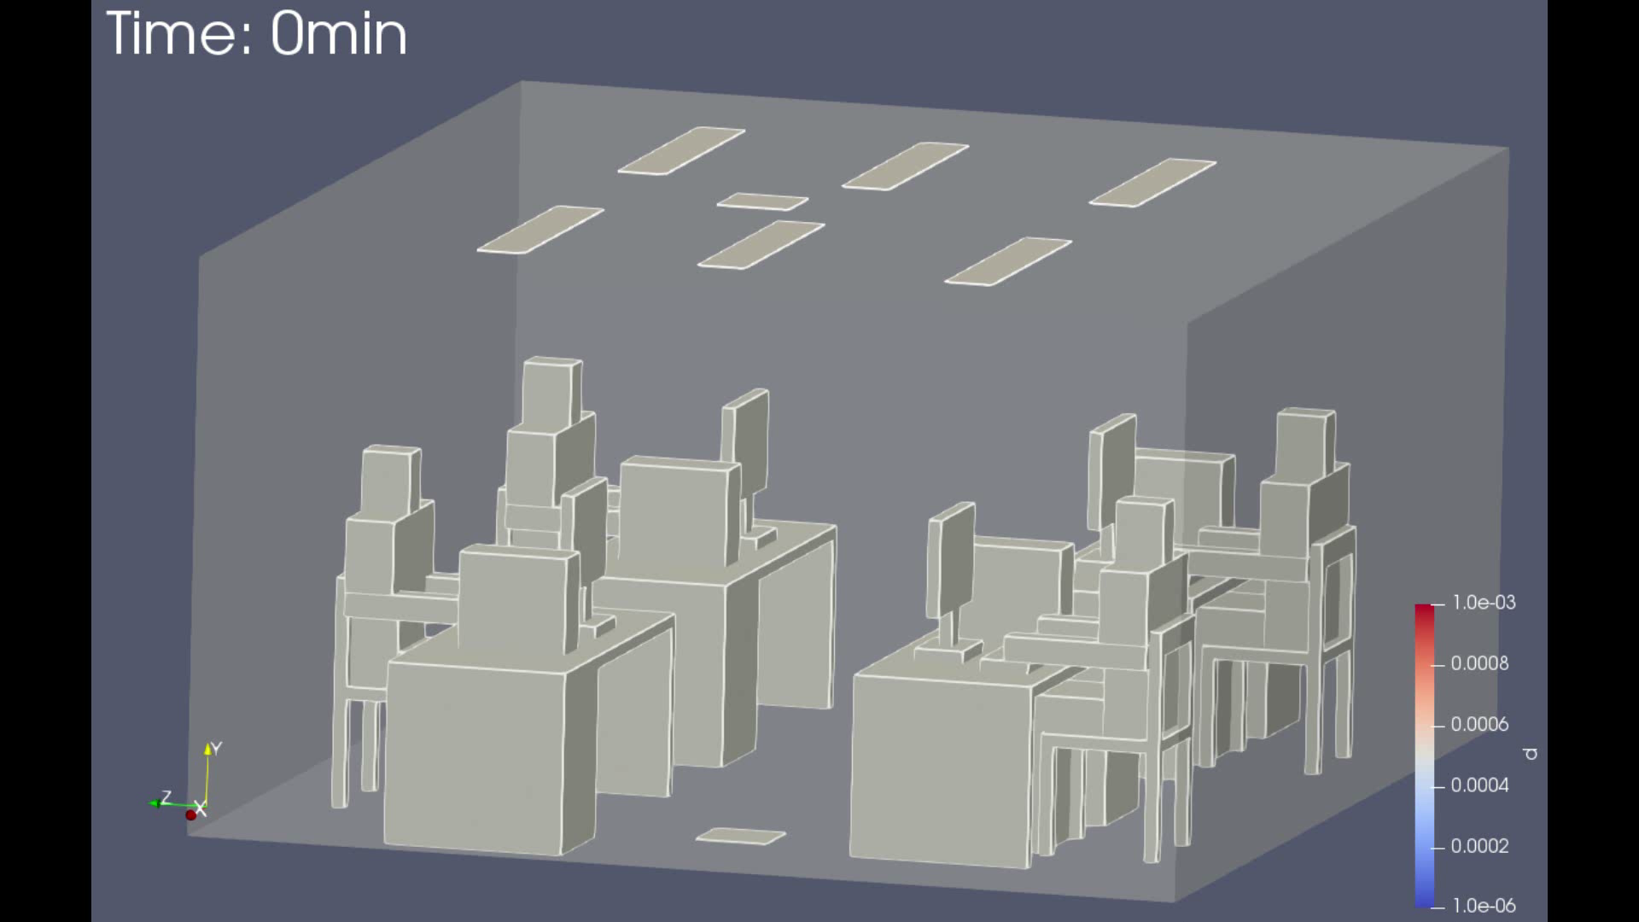
Explained Phenomenon Lesson 4 Video: Standard Case
As it can be seen in the videos below, representing each one of the three breathing regimes with the standard room, the observed phenomenon are identical to the lesson 3. The one difference is the bigger number of geometries in the room and, as such, more obstacles to the trajectory of the particles.
The consequence is an increase of particles inside the room, at the end of the simulation, which means a bigger infection risk for the occupants.
Speaking
Sneezing
Coughing
_____________________
This project has received funding from the European Union’s Horizon 2020
research and innovation programme under grant agreement No 101006468.

Slide 18
Explained Phenomenon Lesson 4 Video : Ventilation System in the ceiling case
In this case, with the ventilation system on the ceiling, the observed phenomenon are very similar to the standard case, as the ventilation system is installed in the same place, and the particles are “forced” to go in the same direction (up), being then removed from the room.
The major difference when comparing this case to the standard one is the fact that the whole ventilation system (diffusers and extractor) are installed in the ceiling and, as such, the air flow, which is upward, is not as pronounced as the standard case, which had diffusers in the floor and an extractor in the ceiling.
The major consequence is the bigger dispersion of the particles throughout the room and, as such, a bigger risk of infection to the occupants of the room, as can be seen the videos from this situation in the next slide.
_____________________
This project has received funding from the European Union’s Horizon 2020
research and innovation programme under grant agreement No 101006468.

Slide 19
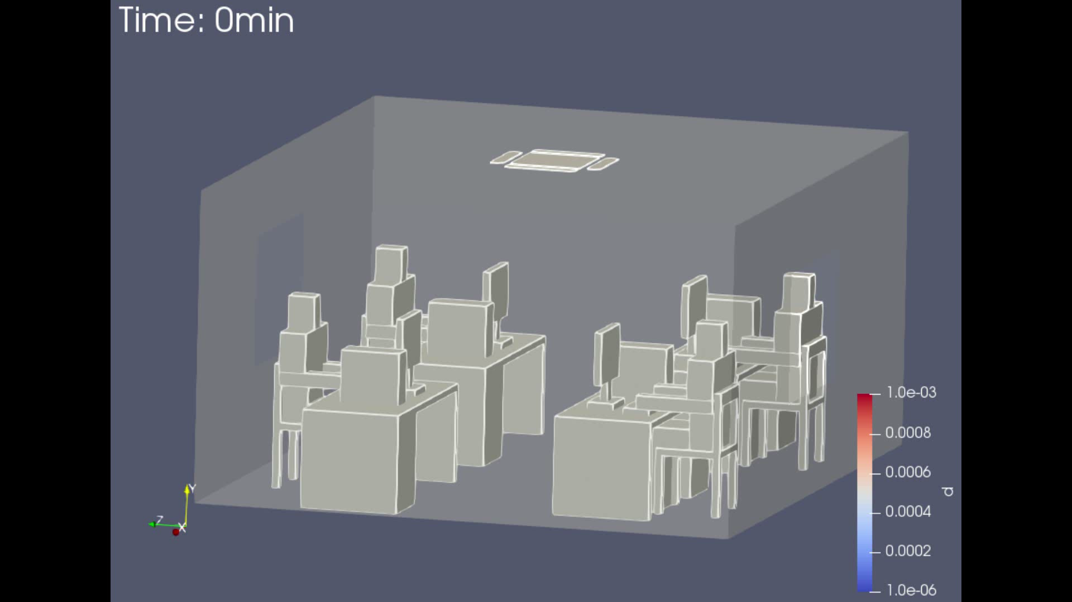
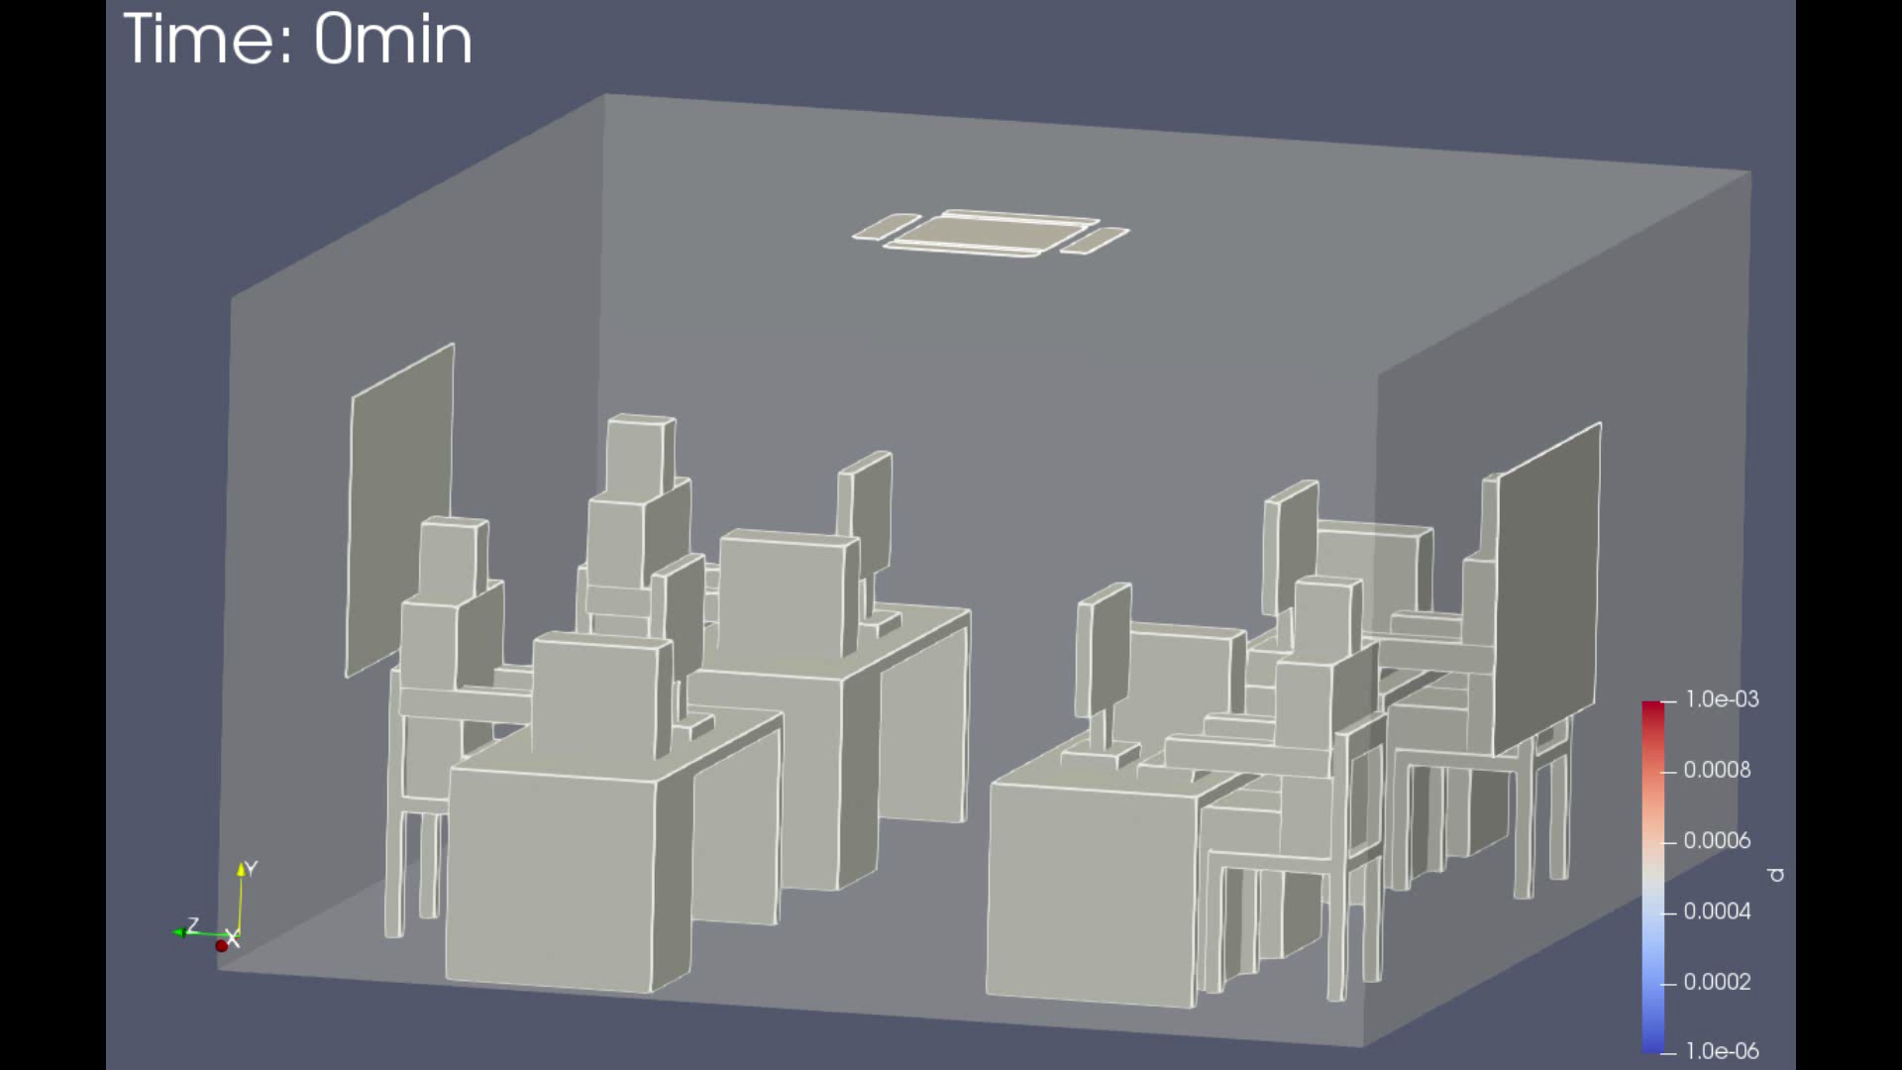
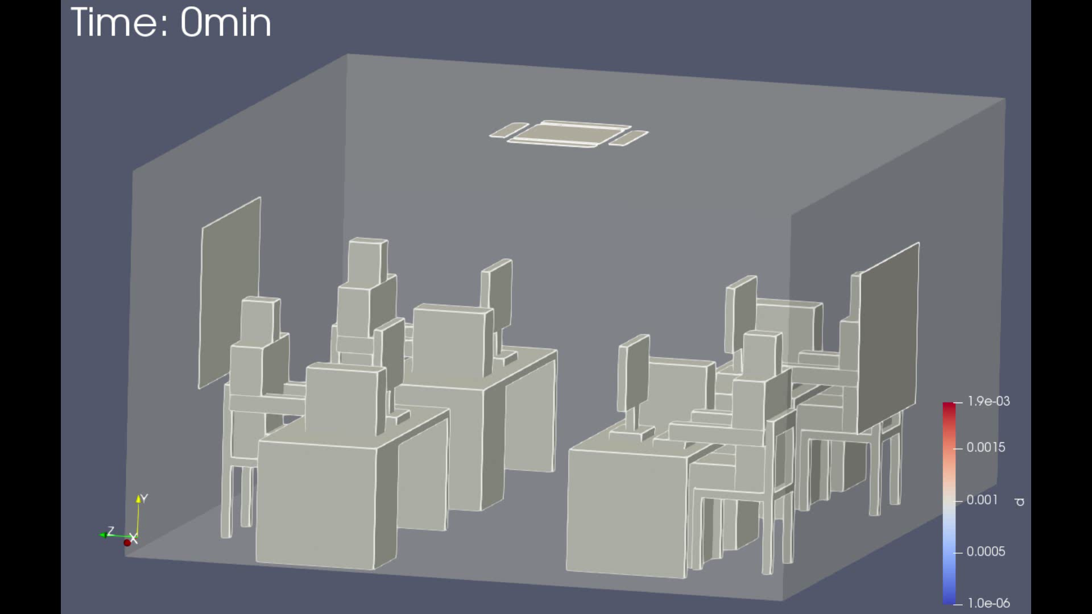
Explained Phenomenon Lesson 4 Video: Ventilation System in the ceiling case
As it can be seen in the videos below, and mainly in the speaking simulation, when compared to the standard case, the particles are more dispersed at the end of the simulation and, as such, the infection risk of the occupants of the room is bigger.
Speaking
Sneezing
Coughing
_____________________
This project has received funding from the European Union’s Horizon 2020
research and innovation programme under grant agreement No 101006468.

Slide 20
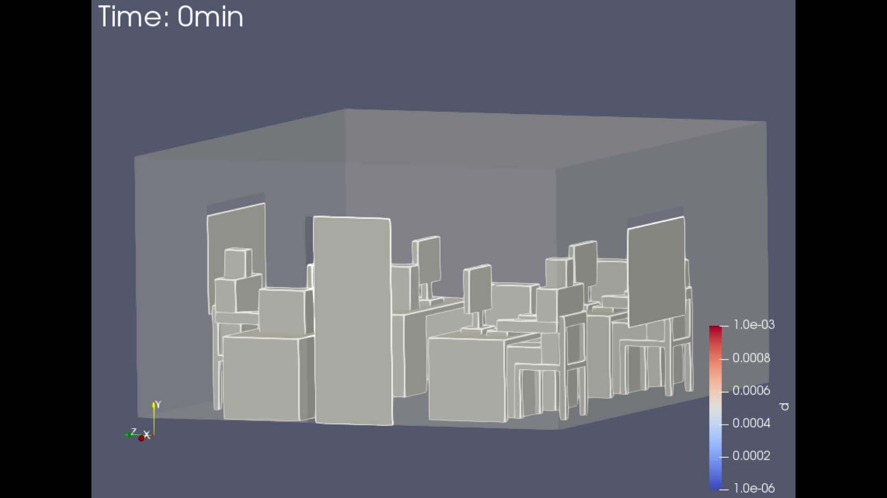
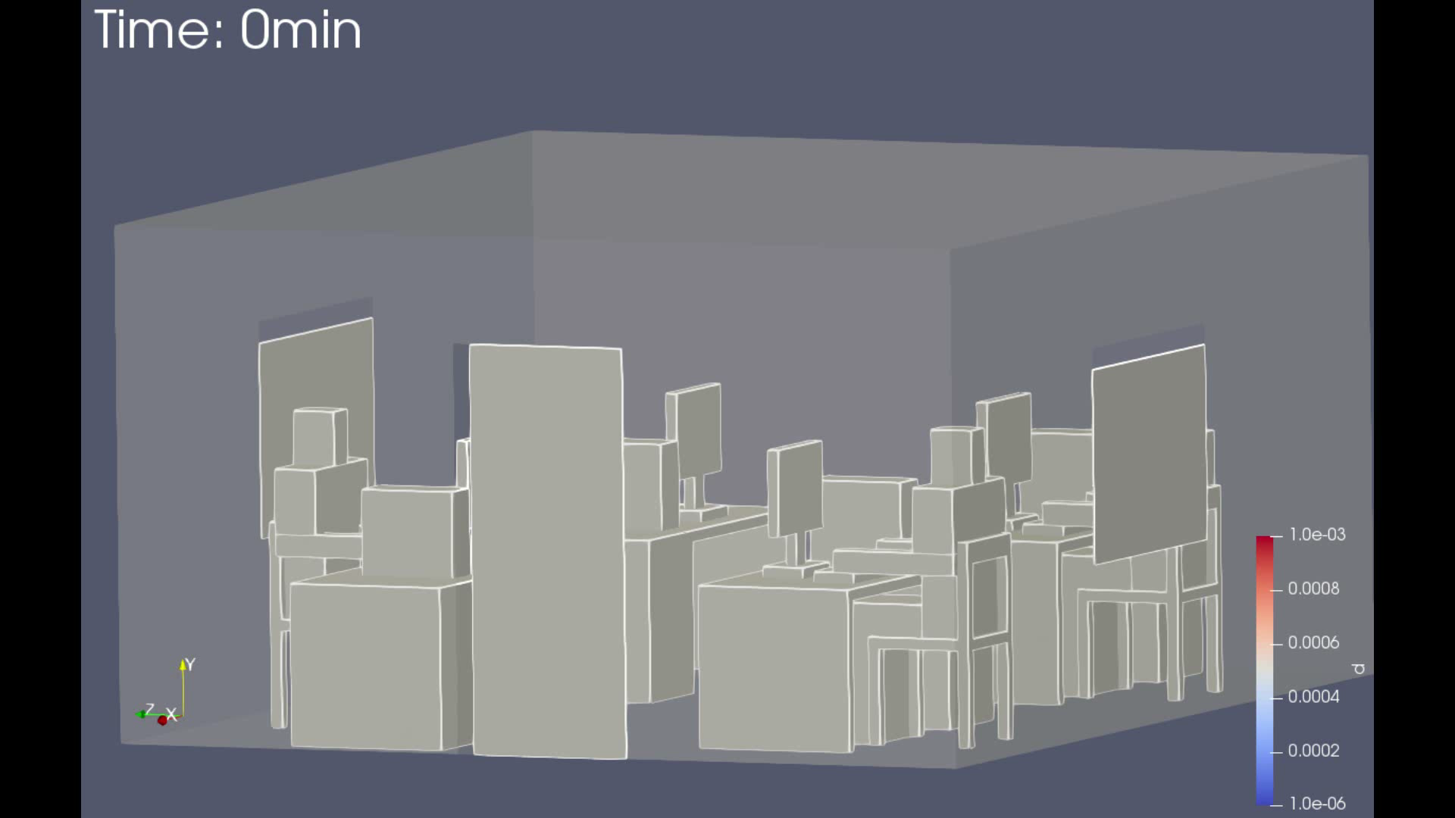
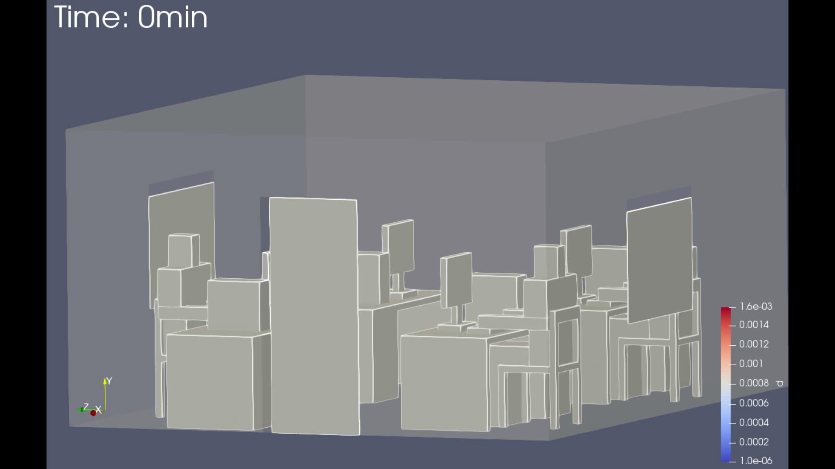
Explained Phenomenon Lesson 4 Video : Natural Ventilation System
In this case, the windows are open at 10% of their capacity, as is the door. The air flow is coming from the windows to the opening of the door.
Such as the ventilation system in the ceiling, in this situation it is also verified a greater dispersion of the particles within the room, meaning that the occupants risk infection is also bigger when compared to the standard case, as it can be seen in the videos below.
This happens because the opening of the door is small, and the speed of the air entering the windows is also minor.
Speaking
Sneezing
Coughing
_____________________
This project has received funding from the European Union’s Horizon 2020
research and innovation programme under grant agreement No 101006468.

