Slide 1



2021
Scenario 2
Tutorial: How to write and read a Scientific Document
PAFSE: Partnerships for Science Education
Project approved under Horizon 2020: Science with and for Society
Call: H2020-SwafS-2018-2020
Topic: Open schooling and collaboration on science education
_____________________
This project has received funding from the European Union’s Horizon 2020
research and innovation programme under grant agreement No 101006468.

Slide 2
Why Read Scientific Documents?
Usually they contain the most recent information about a certain theme;
The current information in this sorts of documents is trustworthy, and, as such, it can be used to help us to create our scientific documents!
BUT…
We should never totally copy paste the information from a scientific article. Instead, just refer to it and take some ideas that could help your work!
_____________________
This project has received funding from the European Union’s Horizon 2020
research and innovation programme under grant agreement No 101006468.

Slide 3
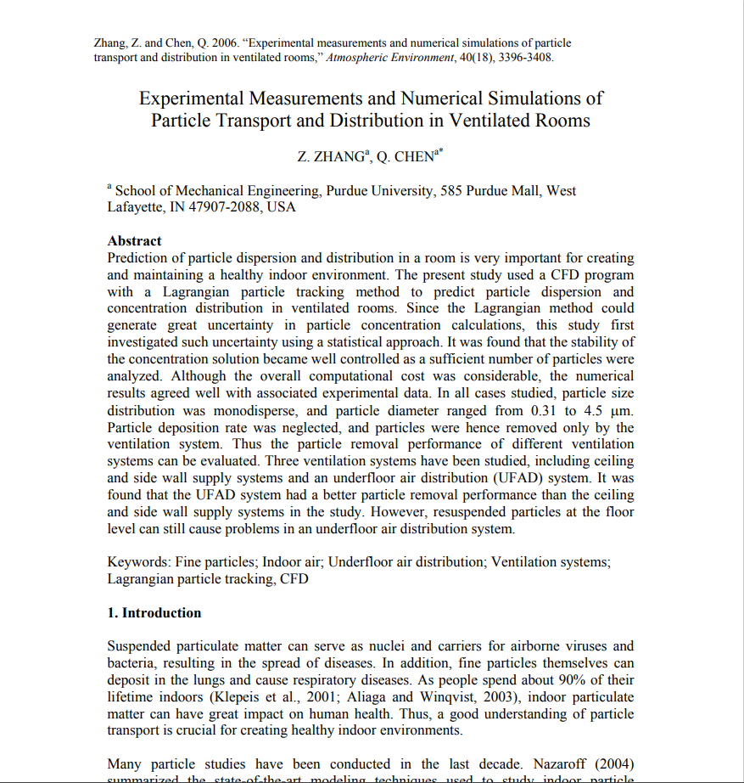
How to read a scientific article?
_
_____________________
This project has received funding from the European Union’s Horizon 2020
research and innovation programme under grant agreement No 101006468.

Slide 4
How to read a scientific article?
Regularly, not all the information in an article is relevant to the work that is being created.
During the production of a scientific document, the information may come from various articles.
As such, for the most part, the following methodology is followed in order to take information from a scientific article:
Starting with reading the title. If the title meets our theme, we should read the abstract.
If the abstract contains relevant information, we should continue to analyzing the article’s introduction, which comer after the abstract.
After consulting the introduction, and if we are sure that the article is, in fact, important, we should analyze the articles conclusions. Usually, they contain the information necessary for our work.
_____________________
This project has received funding from the European Union’s Horizon 2020
research and innovation programme under grant agreement No 101006468.

Slide 5
How to read a scientific article (example)
Read the Abstract
The abstract is right under the title and the name of the article’s authors.
This section is usually not longer than 15/20 lines, and it contains the general information of the article. In other words, it explains how it is organized, the general theme and some conclusions.
It allows us to sort the information in the article, and to understand if it contains useful information to our work.
_____________________
This project has received funding from the European Union’s Horizon 2020
research and innovation programme under grant agreement No 101006468.

Slide 6
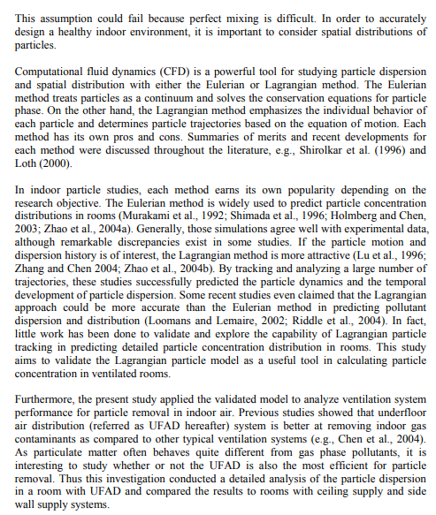
How to read a scientific article (example)
2. Read the Introduction
Usually, the introduction is about one to two pages, and it contains more detailed information on how the article was structured.
It is located right next to the abstract.
_____________________
This project has received funding from the European Union’s Horizon 2020
research and innovation programme under grant agreement No 101006468.

Slide 7
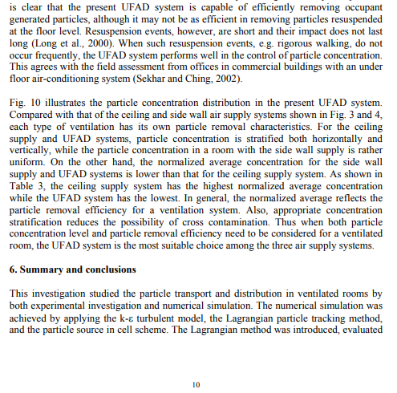
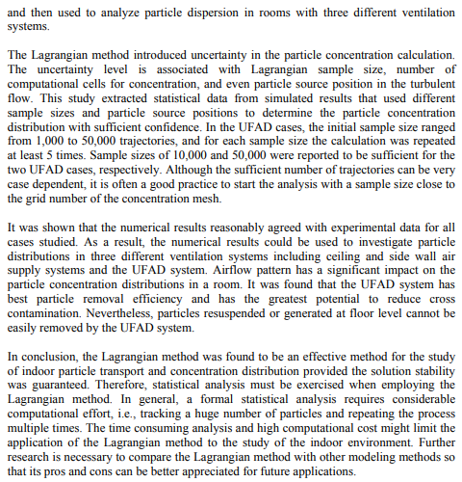
How to read a scientific article (example)
3. Read the Conclusion
The conclusion is in the end of the article. It is usually one to two pages long, and it contains, in a summarized way, the general ideas and conclusions of the work.
This section ends up as the most important to analyze, as it is the one with the most useful information for the creation of our work.
_____________________
This project has received funding from the European Union’s Horizon 2020
research and innovation programme under grant agreement No 101006468.

Slide 8

How to write a scientific document
_
_____________________
This project has received funding from the European Union’s Horizon 2020
research and innovation programme under grant agreement No 101006468.

Slide 9
Abstract
Objective:
  Marketing: convince the reader to keep on reading;
  Self-supporting information: it should resemble a gathering of everything essential to this work.
Content:
  - Problem establishing and relevancy;
  Goals of the document;
  Main results and conclusions;
_____________________
This project has received funding from the European Union’s Horizon 2020
research and innovation programme under grant agreement No 101006468.

Slide 10
Introduction
Problem introduction and its relevancy:
– Mention prior approaches;
Target definition and scope of the proposed work;
Document organization.
_____________________
This project has received funding from the European Union’s Horizon 2020
research and innovation programme under grant agreement No 101006468.

Slide 11
Literature Survey
Problem establishing and solutions;
Identifying existing gaps;
Occasionally, it can be divided into more than one chapter, depending on the complexity or interdisciplinary of the problem.
_____________________
This project has received funding from the European Union’s Horizon 2020
research and innovation programme under grant agreement No 101006468.

Slide 12
Methodology
Describing the used method to create the document;
Usually, it combines several strategies already existing with innovations and adaptations to solve the existing problem.
_____________________
This project has received funding from the European Union’s Horizon 2020
research and innovation programme under grant agreement No 101006468.

Slide 13
Results and discussion
Brief results presentation:
  Extensive listings should be listed as an append.
Tables and figures:
  Structure the information, show essential questions, oscillate between the type of texto.
Explain successful and unsucesseful events;
The chapter can be divided if the amount of data and results so justifies.
_____________________
This project has received funding from the European Union’s Horizon 2020
research and innovation programme under grant agreement No 101006468.

Slide 14
Conclusions
Work summary:
  Do not bring up new data;
  Do not quote references.
Main results, reinforcing innovation and target compliance;
Recommendation of summaries (if appropriated)
Future developments (new content);
_____________________
This project has received funding from the European Union’s Horizon 2020
research and innovation programme under grant agreement No 101006468.

Slide 15
Bibliographical references
Target: identify, simply and cleary, the referenced literature.
Every referenced literature, and only the referenced one, should be on the reference list:
– Quoted documents on the text;
- Tables and figures;
– Published literature, including eletronic.
Literature identified in the context (such as National Legislation or the Bible do not need to be on the list).
Frequent types: APA, Vancouver, IEEE;
_____________________
This project has received funding from the European Union’s Horizon 2020
research and innovation programme under grant agreement No 101006468.

Slide 16
Bibliographical references
APA typology (American Psychological Association):
- How to write (book):
Author(s). (Year). Book title (Edition number). Publishing house
Surname, A. A. (publishing date). Title. Title supplement (Edition number). Publishing house.
Example:
Giddens, A. (2011). Sociologia (6.ª ed.). Fundação Calouste Gulbenkian.
_____________________
This project has received funding from the European Union’s Horizon 2020
research and innovation programme under grant agreement No 101006468.

Slide 17
Bibliographical references
Vancouver typology:
- How to write (book):
Author(s). Book title. Edition number. Publishing place; Publishing house; Publishing year.
To identify the website::
Author(s). Book title. Edition number. Publishing house; Publishing year. Available at: (website link).
Example:
Marôco J. Análise estatística com o SPSS Statistics. 9. rev. ed. Pero Pinheiro: Report Number; 2011.
_____________________
This project has received funding from the European Union’s Horizon 2020
research and innovation programme under grant agreement No 101006468.

Slide 18
Bibliographical references
IEEE typology (Institute of Electrical and Electronics Engineers):
- How to write (book):
Author(s). Book title: Subtitle (if available). Edition number. Publishing place. Publishing house. Publishing year.
Example:
A.Gupta and D.Yan, Mineral processing Design and Operations: An Introduction. 2nd. ed. Amesterdam: Elsevier, 2016.
_____________________
This project has received funding from the European Union’s Horizon 2020
research and innovation programme under grant agreement No 101006468.

Slide 19
Captions (tables)
In tables, put the captions upwards and line them on the left (usually). Tables are read from top to bottom, and should be numbered (table 1,2…);
Captions should contain the table number, the title, and other explanatory information;
Quote the data from other publications, such as in the rest of the document;
The information should have a sequential and logical order.
_____________________
This project has received funding from the European Union’s Horizon 2020
research and innovation programme under grant agreement No 101006468.

Slide 20
Captions (Figures)
In figures, the captions should stay below. Figures can be graphs, images or diagrams, and, as such, are read from bottom to top;
Use titles to figures and graphs in slides and oral presentation posters;
Captions should contain the number of the figure, the title and other informations, if necessary;
Quote the data from other publications, such as in the rest of the document;
The information should have a sequential and logical order.
_____________________
This project has received funding from the European Union’s Horizon 2020
research and innovation programme under grant agreement No 101006468.

Slide 21
At last…
REVIEW THE WORK!
Always take some time to revise the work;
Ask someone else to review the work;
Watch out for grammar mistakes!
_____________________
This project has received funding from the European Union’s Horizon 2020
research and innovation programme under grant agreement No 101006468.

Slide 22
See you later!
_____________________
This project has received funding from the European Union’s Horizon 2020
research and innovation programme under grant agreement No 101006468.

