Slide 1
What is Health?
Health is a state of complete physical, mental and social well-being and not merely the absence of disease or infirmity (WHO, 1948).
Health is an essential part of the quality of life. It is considered as a form of human capital. Poor health can affect the progress of society.
Mental
Physical
Social
Health
Health is also the ability of every citizen to adapt and manage physical, social and emotional challenges (Huber, 2011).

Slide 2
What is Health?
Health 4All
Health is a fundamental human right
and an investment in a democratic and just society.
“The enjoyment of the highest attainable standard of health is one of the fundamental rights of every human being without distinction of race, religion, political belief, economic or social condition”.
Source: https://www.who.int/news-room/commentaries/detail/health-is-a-fundamental-human-right

Slide 3
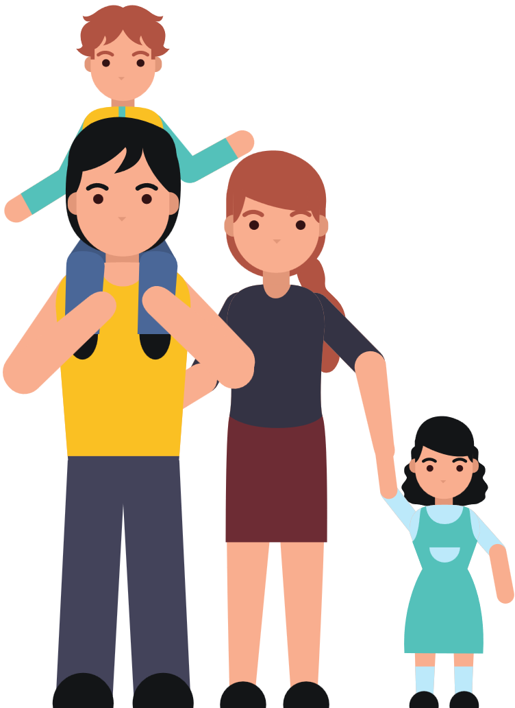
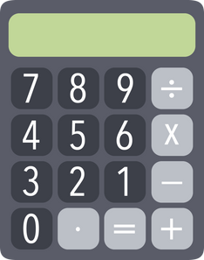
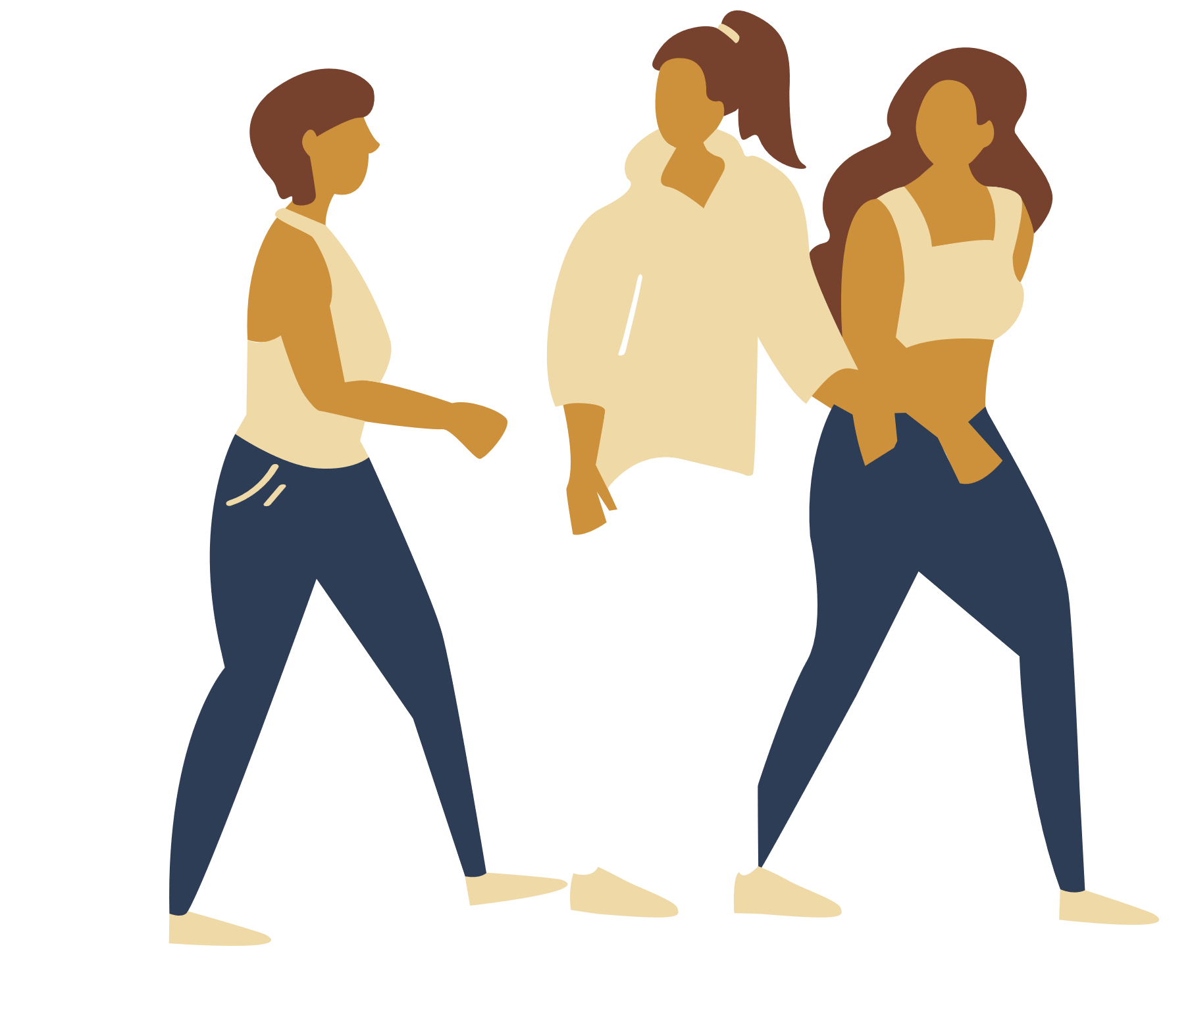
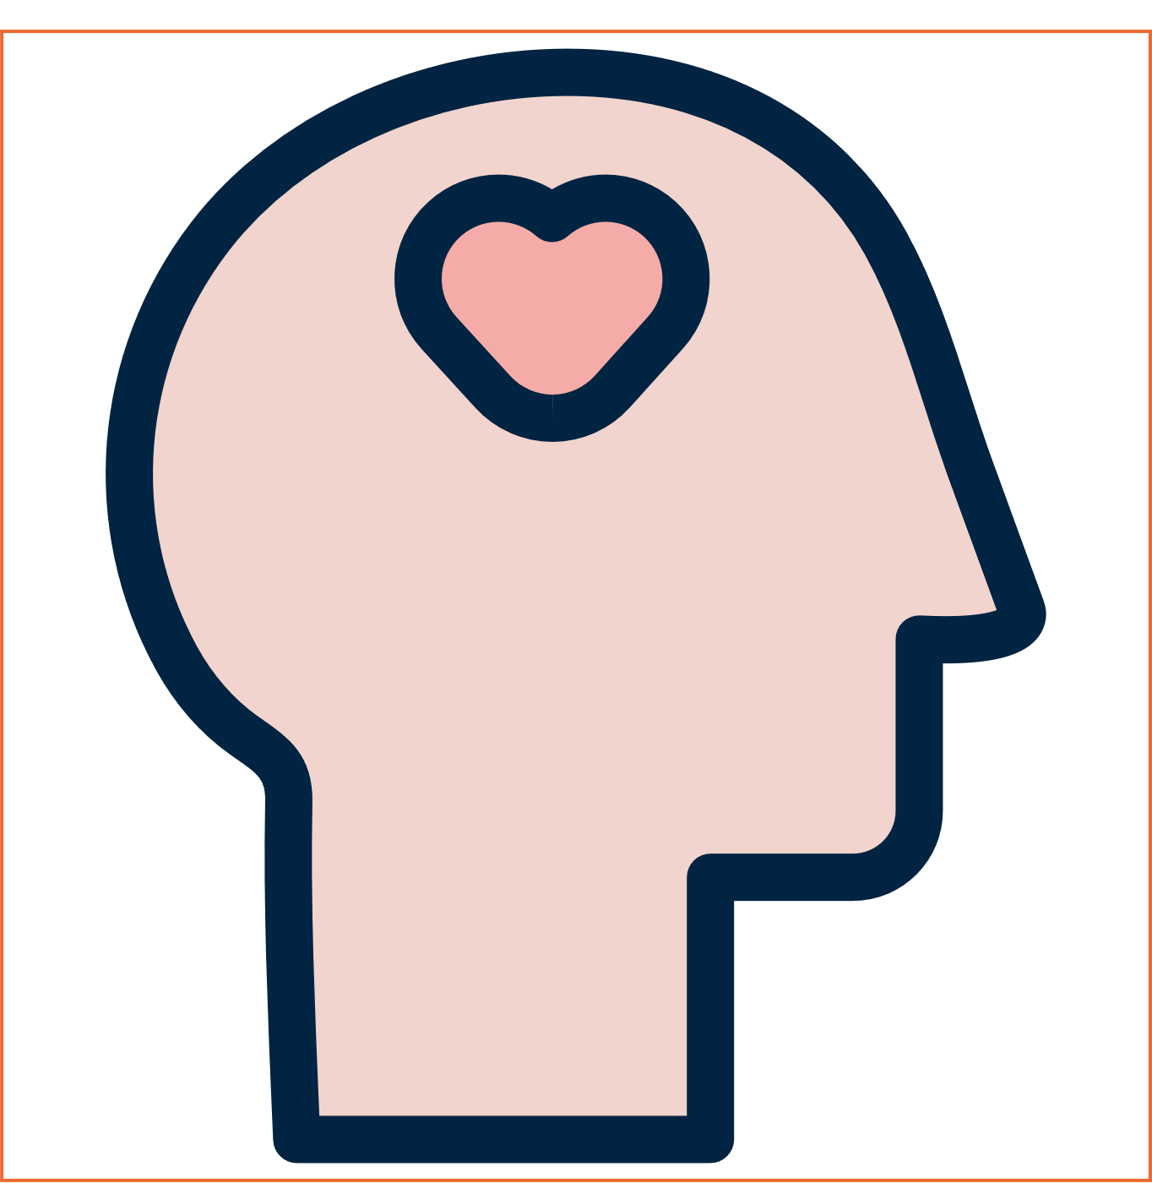
Quality of Life
Quality of life is individual’s perception of their position in life in the context of the culture and value systems in which they live and in relation to their goals, expectations, standards and concerns (WHO, 1997).
Health &
wellness
Emotional
Spiritual
Physical
Social
Occupational
Financial
Environmental
Work-life
balance
Positive
Health
Work & Job quality
Quality
of Life
Income & wealth
Economic & Legal
Personal Safety
Leisure &
social interactions
Environmental &
Housing Conditions
Positive Health
Local Resources
Infrastructures
& Services
Positive health, or well-being, is a resource for quality of life.
Quality of life is closely connected to people’s ideas about what is a “good life.
Education &
Knowledge & skills

Slide 4
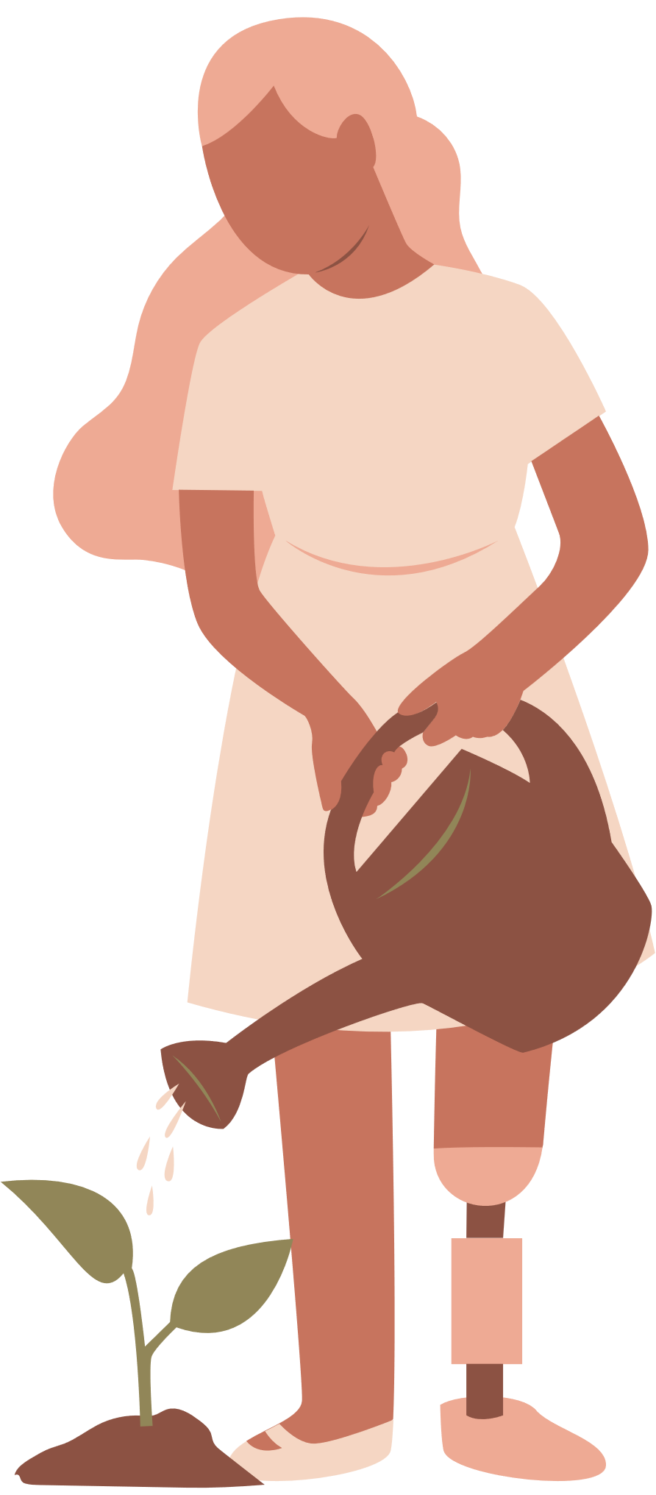
Quality of life is closely connected to people ideas about what is a “good life”. Has been influenced by the evolution of science and technology over the decades.
Quality of life
Being.
Related to the physical, psychological and spiritual dimensions of individuals lives. It´s about the present.
It´s about: knowing yourselves, maintaining relationships with others, engaging with life joys and complexities, and meeting challenges.
Belonging.
Involves the social, relational and work environment – knowing where and with whom you belong is integral to human existence, it shapes who you are and who you can become.
Becoming.
Reflects the process of rapid and significant change that occurs in the early years as young children learn and grow. It emphasises learning to participate fully and actively in society.
Source: The Early Years Learning Framework for Australia (2009)

Slide 5
Health-related quality
of life
Health is not only a
determinant of the expectancy of life.
It also plays an important role on individuals functional capabilities that in turn have an impact on their quality of life.
HRQOL

Slide 6
Health-related quality of Life (HRQOL)
“An individual’s or group’s perceived physical and mental health over time.”
Individual
Community
Physical and mental health perceptions (e.g., energy level, mood) and their correlates (health risks and conditions, functional status, social support, and socioeconomic status).
Community-level resources, conditions, policies, and practices that influence a population’s health perceptions and functional status.
Source: https://www.cdc.gov/hrqol/concept.htm

Slide 7
Quality of Life
Health &
wellness
Work-life
balance
Work & Job quality
Quality
of Life
Income & wealth
Economic & Legal
Personal Safety
Leisure &
social interactions
Environmental &
Housing Conditions
Local Resources
Infrastructures
& Services
Education &
Knowledge & skills

Slide 8
Quality time with family and friends
Gender gap in total hours worked
Long unpaid working hours
Satisfaction with time use
Health &
wellness
Feelings of safety when walking alone at night
Work-life
balance
Homicides & Robberies
Road Safety
Work & Job quality
Quality
of Life
Income & wealth
Electoral participation
Trust in institutions
Economic & Legal
Personal Safety
Time spent on leisure activities
Volunteering
Leisure &
social interactions
Environmental &
Housing Conditions
Social support
Time spent in social interactions
Satisfaction with personal relationships
Local Resources
Infrastructures
& Services
Education &
Knowledge & skills
Access to higher education
Knowledge and competences

Slide 9
Life satisfaction
Perceived health
Life expectancy at birth
Access to healthcare
Health &
wellness
Labour market insecurity
Work-life
balance
Employment rate
Long hours of inpaid work
Work & Job quality
Earnings
Quality
of Life
Income & wealth
Working environment
Economic & Legal
Personal Safety
Access to basic sanitary facilities
Housing affordability
Leisure &
social interactions
Environmental &
Housing Conditions
Access to recreational green space in urban areas
Local Resources
Infrastructures
& Services
Noise pollution
Exposure to outdoor air pollution
Education &
Knowledge & skills
Energy, water, transport & telecommunication networks
Access to libraries, schools, hospital, market, restaurants, bank, workshops, leisure and cultural spaces

Slide 10
Quality time with family and friends
Life satisfaction
Gender gap in total hours worked
Perceived health
Long unpaid working hours
Life expectancy at birth
Satisfaction with time use
Access to healthcare
Health &
wellness
Feelings of safety
when walking alone at night
Labour market insecurity
Work-life
balance
Homicides & Robberies
Employment rate
Road Safety
Work & Job quality
Long hours of inpaid work
Electoral participation
Quality
of Life
Income & wealth
Earnings
Trust in institutions
Economic & Legal
Personal Safety
Quality of the working
environment
Time spent on
leisure activities
Access to basic sanitary facilities
Volunteering
Leisure &
social interactions
Environmental &
Housing Conditions
Housing affordability
Social support
Access to recreational green
space in urban areas
Satisfaction with
personal relationships
Local Resources
Infrastructures
& Services
Noise pollution
Time spent in social interactions
Exposure to outdoor air pollution
Education &
Knowledge & skills
Energy, water, transport &
telecommunication networks
Access to higher education
Knowledge and competences
Access to library, schools, hospital, market,
restaurants, bank, workshops, leisure and cultural spaces

